Slide 1
Single-center Phase I/II Trial of Sodium Oxybate in Patients with Alternating Hemiplegia of Childhood
(AHC-SO)
Aga Julia Lewelt, MD
Physical Medicine and Rehabilitation
University of Utah
AHC Family Meeting
July 22, 2011

Slide 2
Unknown disease pathology and no effective treatment
The pathologic basis for symptoms and signs in AHC remains uncertain. Unknown cause.
Therapeutic options for AHC remain limited
Sleep, whether natural or induced with medications, remains the most reliable and effective strategy for symptomatic relief in most children

Slide 3
Gamma-hydroxybutyric acid
GHB is a naturally occurring fatty acid found in all major organ systems, including the brain
  Fatty acids = building blocks of the fat in our bodies
GHB has been used in children for sedation and for anesthesia
However, GHB has a narrow benefit/risk margin due to its potent impact on respiratory drive at higher doses
Duration of action, compared to most medications, is short

Slide 4
Sodium oxybate (SO)
Sodium oxybate (SO), a derivative of GHB, is clinically used to induce sleep in people with narcolepsy
  Narcolepsy - chronic sleep disorder characterized by an excessive urge to sleep in inappropriate times
Sleep reliably arrests AHC episodes, so this property is appealing
SO might be effective in aborting prolonged AHC episodes
SO has a very short half-life, about 30-60 minutes, making it a good choice for use on an as-needed basis

Slide 5
AHC-SO: Main Objective
To perform a phase I/II study to evaluate effects of sodium oxybate in a cohort of 6 children and young adults with AHC
  Phase I - assess drug safety & tolerability
  Phase II - assess how well the drug works
    how much drug should be given
    how well the drug works at the prescribed dose(s)
  Some trials combine Phase I & Phase II
    test both safety and efficacy at the same time

Slide 6
AHC-SO: Specific Objectives
To obtain safety and tolerability data in persons with AHC ages 6 months to 25 years
To assess impact of sodium oxybate on AHC episodes, such as episode duration and episode frequency, using a daily AHC episode log
To determine potential benefit of sodium oxybate on quality of life, functional status, and behavior

Slide 7
Study Design: Pre-drug phase
Online medical history and questionnaires
Daily online AHC Episode Log for 6 weeks prior to initiation of study drug
  A prerequisite for the drug initiation phase
  At least 3 episodes a week

Slide 8
Study Design: Initiation phase
Sunday – Arrival to Salt Lake City, UT
Participant and caregiver travel to the study center and check into pre-arranged university guest housing
Monday – Admission to Center for Clinical and Translational Science (CCTS) Patient Interaction Core
Participant admitted to CCTS for 5 days for SO dose titration
Evaluations:
  review of the consent and current medications
  update of medical history and physical exam
  neuropsychological testing and questionnaires
  blood draw for labs +/- urine for pregnancy test

Slide 9
Study Design: Initiation phase
Monday-Friday - The dose escalation phase
SO administration takes place in the CCTS unit
Increasing doses of SO administered for AHC episodes
  20 mg/kg, 30 mg/kg, 40 mg/kg, 50 mg/kg, 60 mg/kg
  70 mg/kg, 80 mg/kg, up to 90mg/kg/day
Participants monitored closely for drug safety, tolerance, and efficacy by medical staff
Participant’s primary caregiver continues to maintain the daily online AHC Episode Log, including time of administration, dose, and effects of SO

Slide 10
Study Design: Initiation phase
Friday
Labs repeated
CCTS pharmacist dispenses bottle of SO to the primary caregiver
Caregivers provided detailed instructions regarding dosage during episodes for use during subsequent 6-week on-drug study period at home

Slide 11
Study Design: On-drug 6 weeks
The caregiver continues to submit the daily online AHC Episode Log x 6 weeks documenting:
  all AHC episodes
  exact doses and times of SO administration
  duration of episodes before and after SO administration
  any side effects
Participants required to be under adult supervision and on continuous pulse oximetry for at least 4 hours after dose administration
Weekly phone calls by study team

Slide 12
Study Design: Follow up visit
The participant returns to the CCTS for a 1-day evaluation within 1 week of completing the on-drug 6 week phase
This final clinical assessment includes
  interim history and physical
  neuropsychological testing
  questionnaires
  review of amount of remaining study drug
  review on AHC Episode Log data
  option to continue drug
A written plan of action is provided to the family at the time of this follow-up visit, with copies sent to local physicians

Slide 13
Study Design: Maintenance phase
The caregiver continues to submit the daily online AHC Episode Log as able
Study investigators hold conference calls to review and discuss individual participants’ data
Dosing regimens modified
Quarterly phone calls by study team

Slide 14
AHC-SO study design summary
Pre-drug phase: 6 weeks of daily AHC online episode log OFF study drug
Drug initiation phase: 5-day admission to CCTS in Utah for study drug dose titration
On-drug 6 week phase: 6 weeks of daily AHC online episode log ON study drug
Follow up: 1-day follow up visit at CCTS in Utah
Maintenance phase: Optional continuation of study drug and daily online AHC episode log

Slide 15
Results

Slide 16
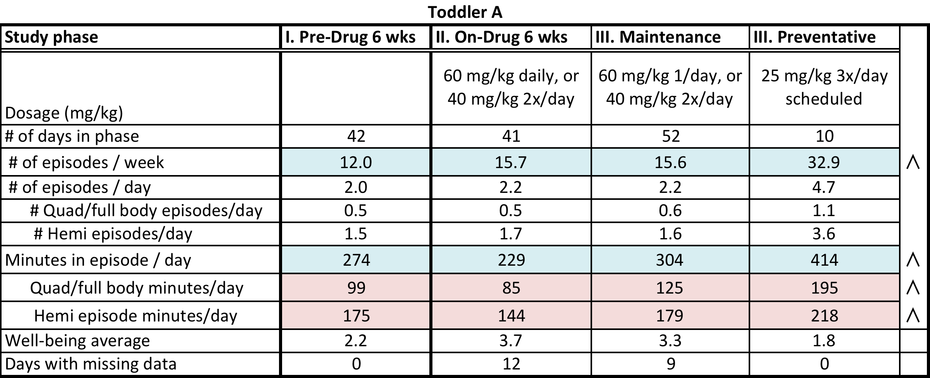
Results

Slide 17
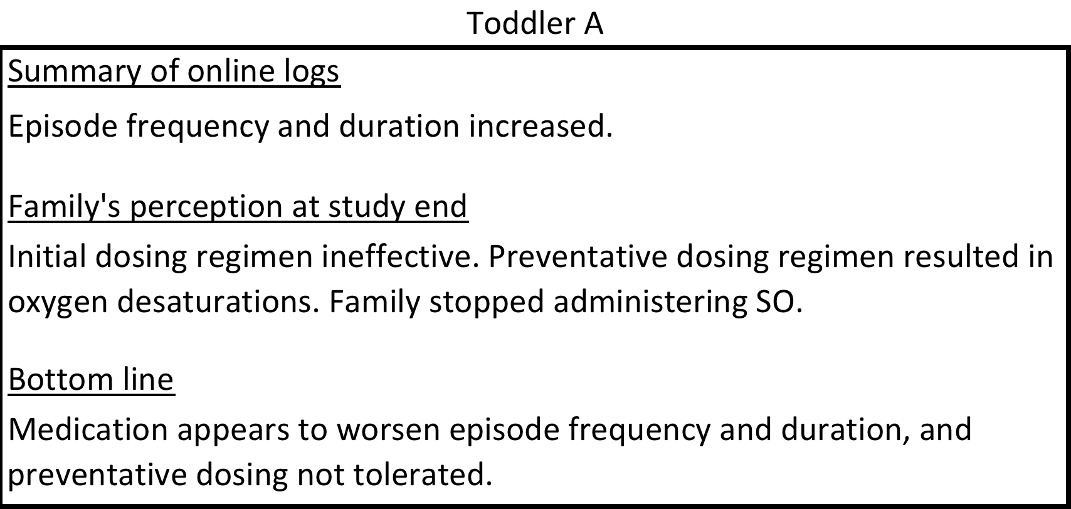
Results

Slide 18
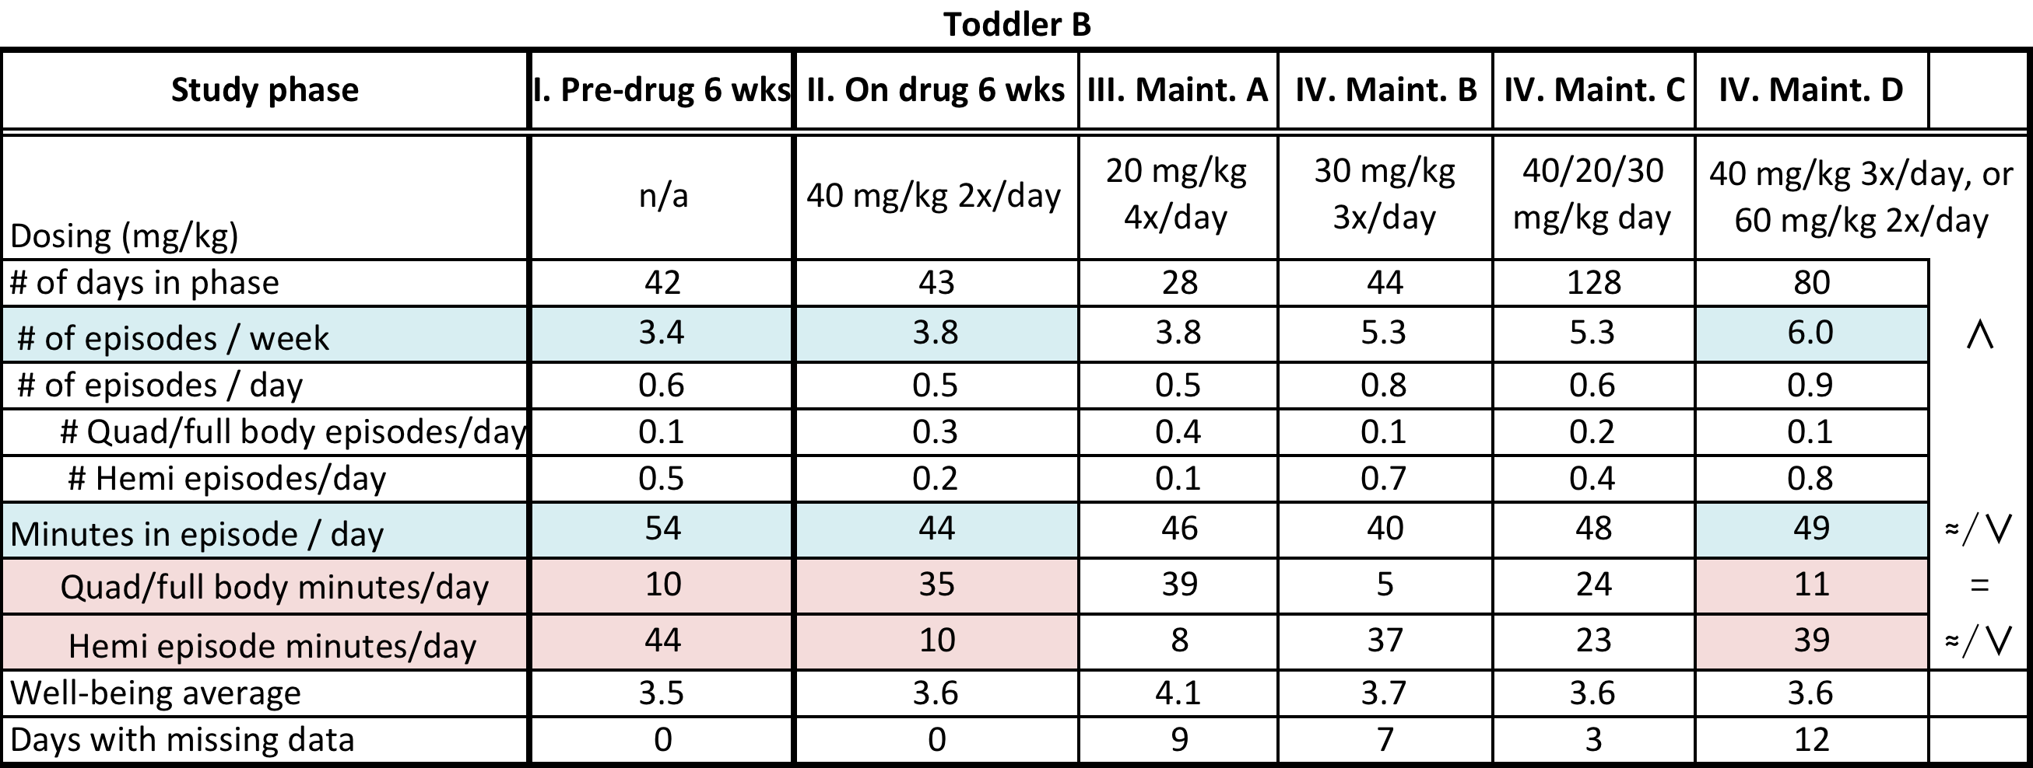
Results

Slide 19
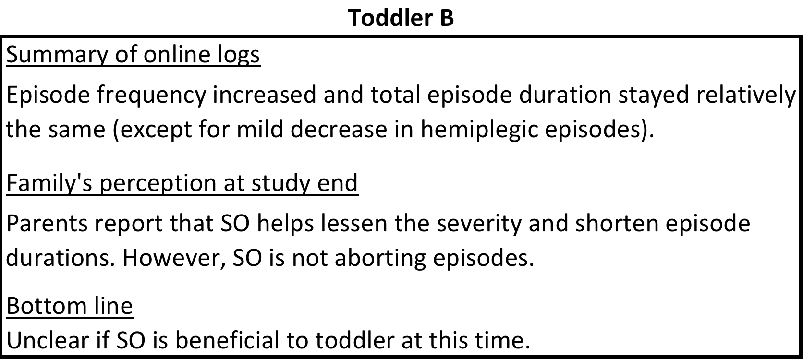
Results

Slide 20
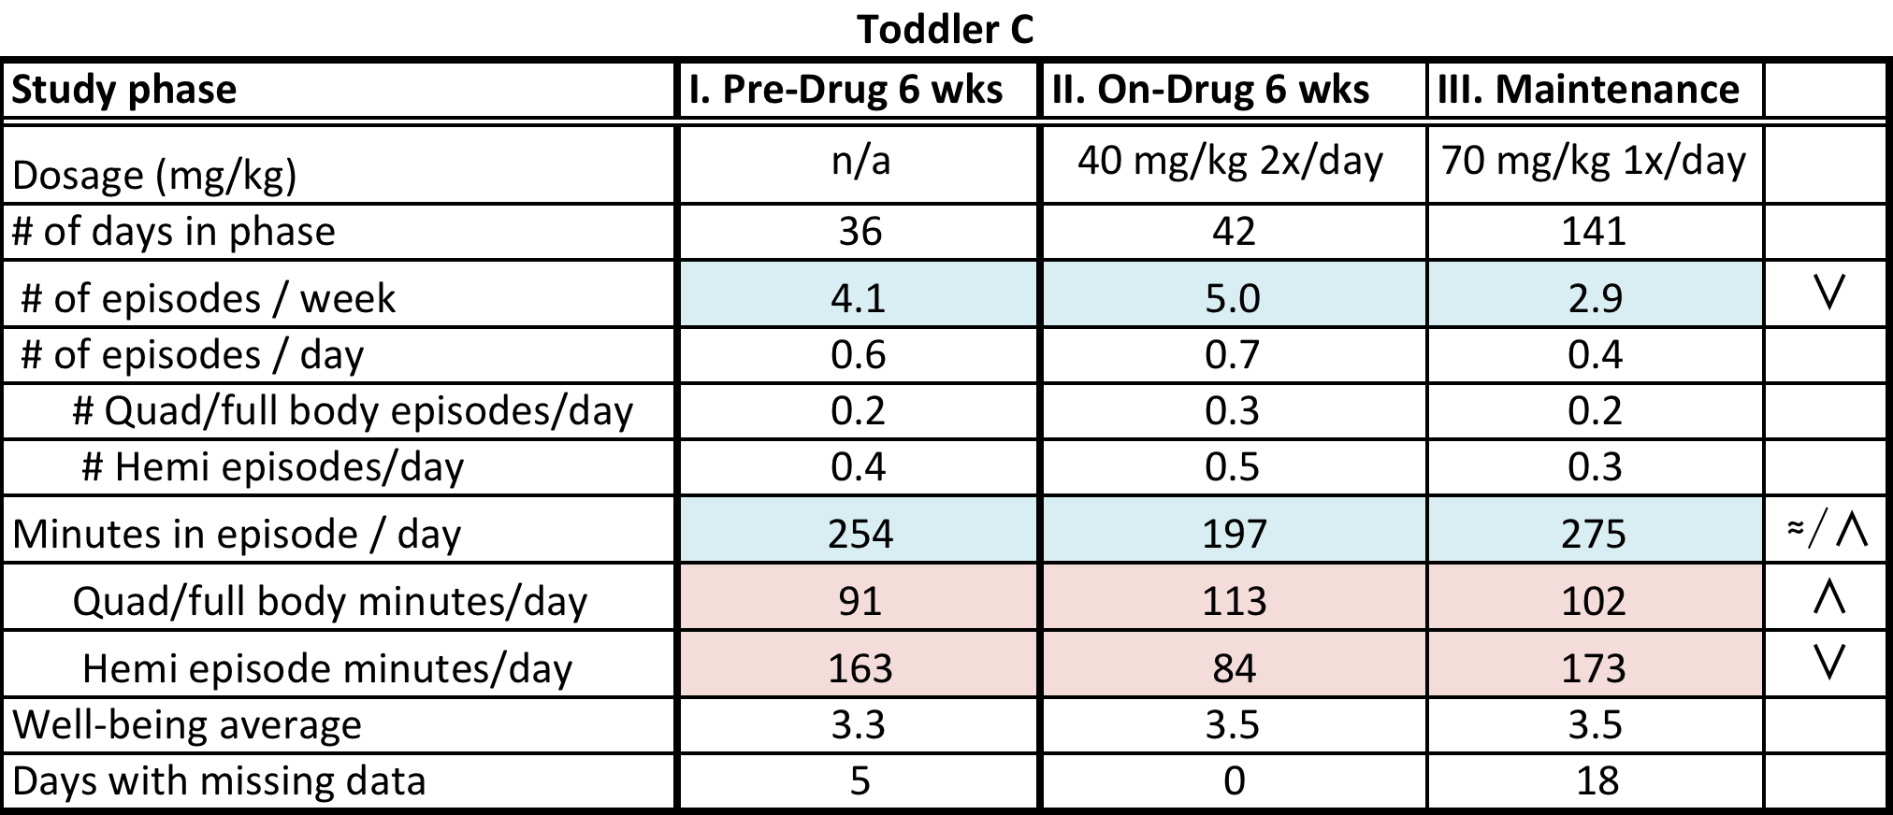
Results

Slide 21
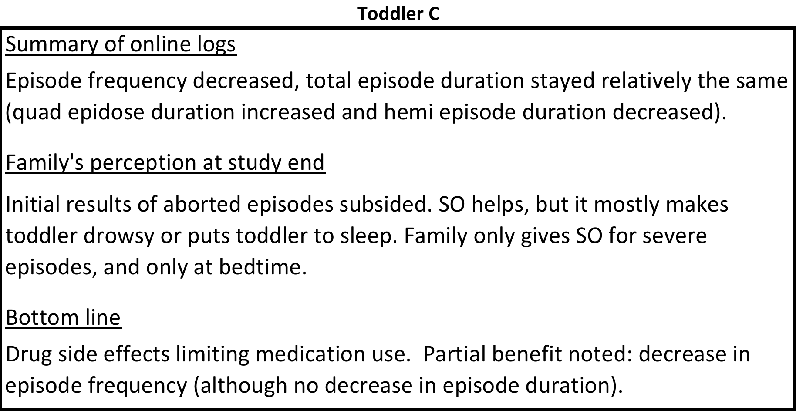
Results

Slide 22
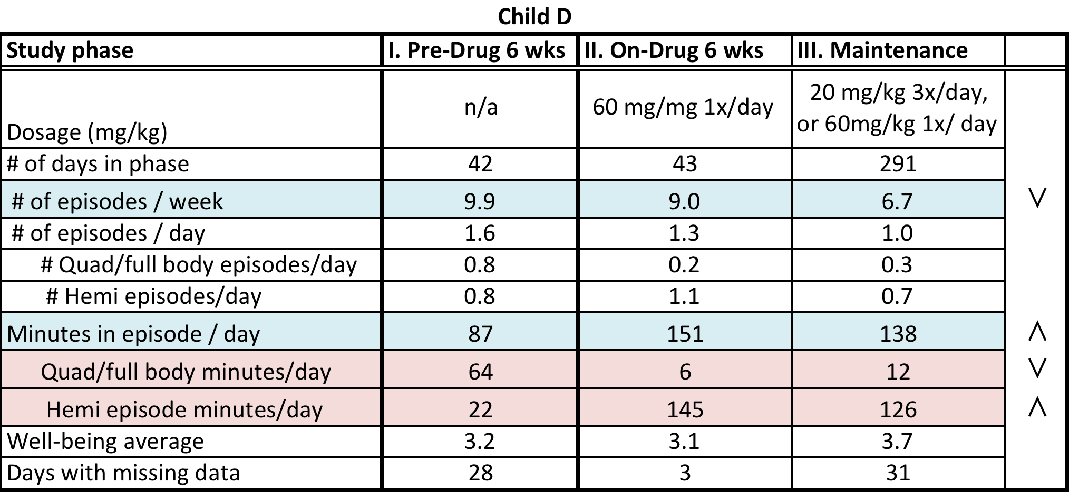
Results

Slide 23
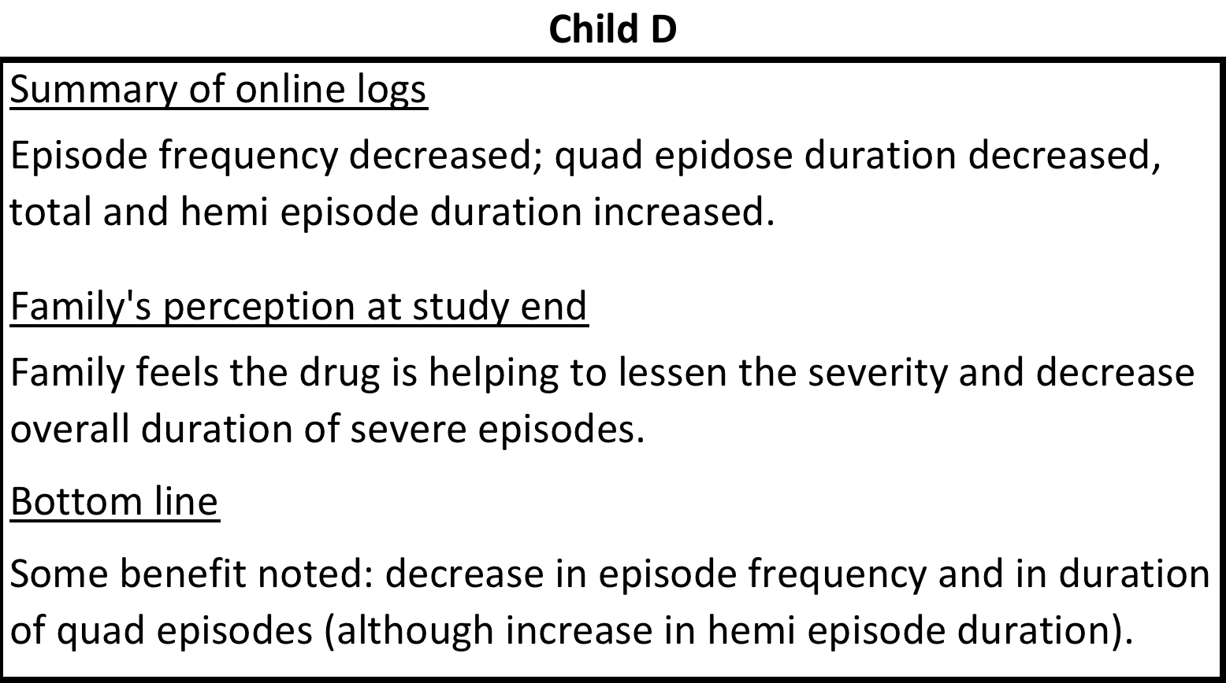
Results

Slide 24
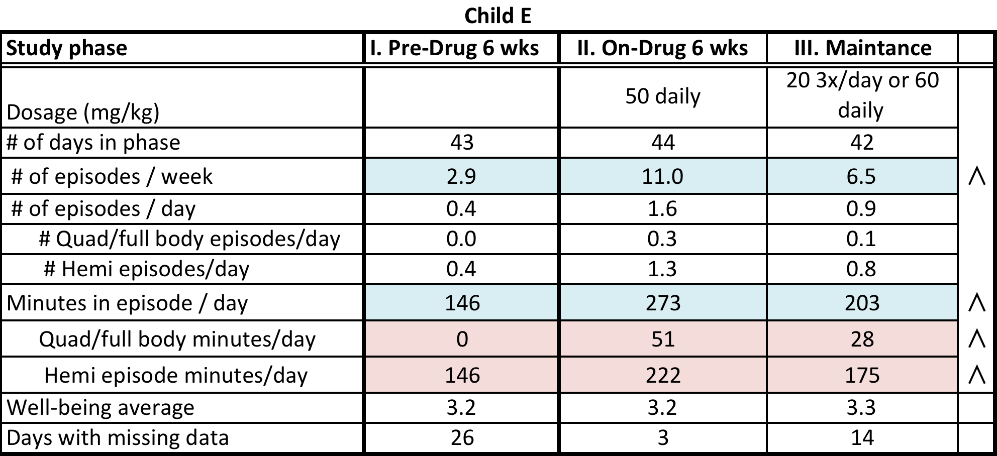
Results

Slide 25
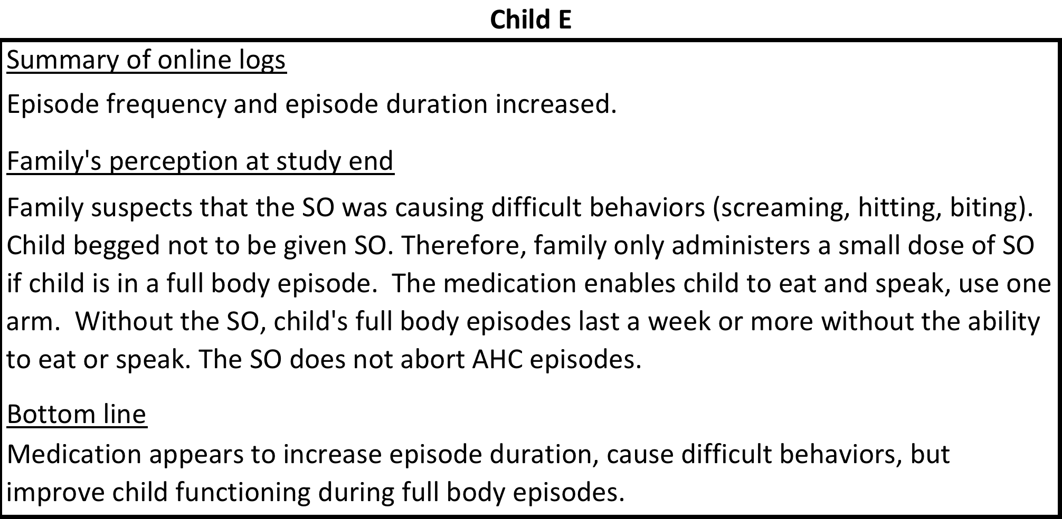
Results

Slide 26
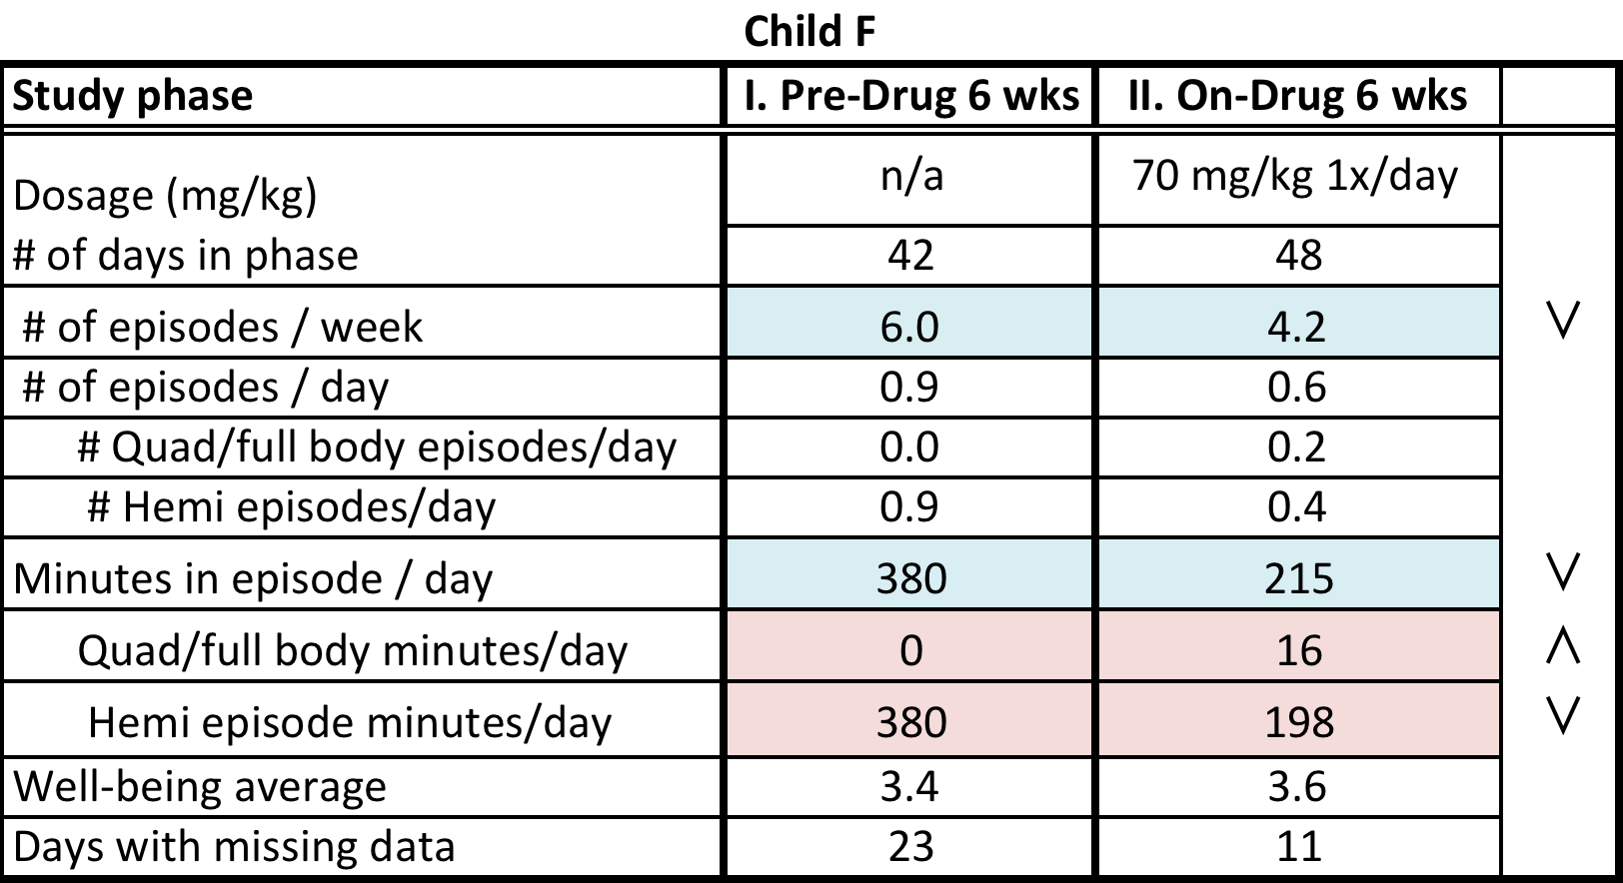
Results

Slide 27
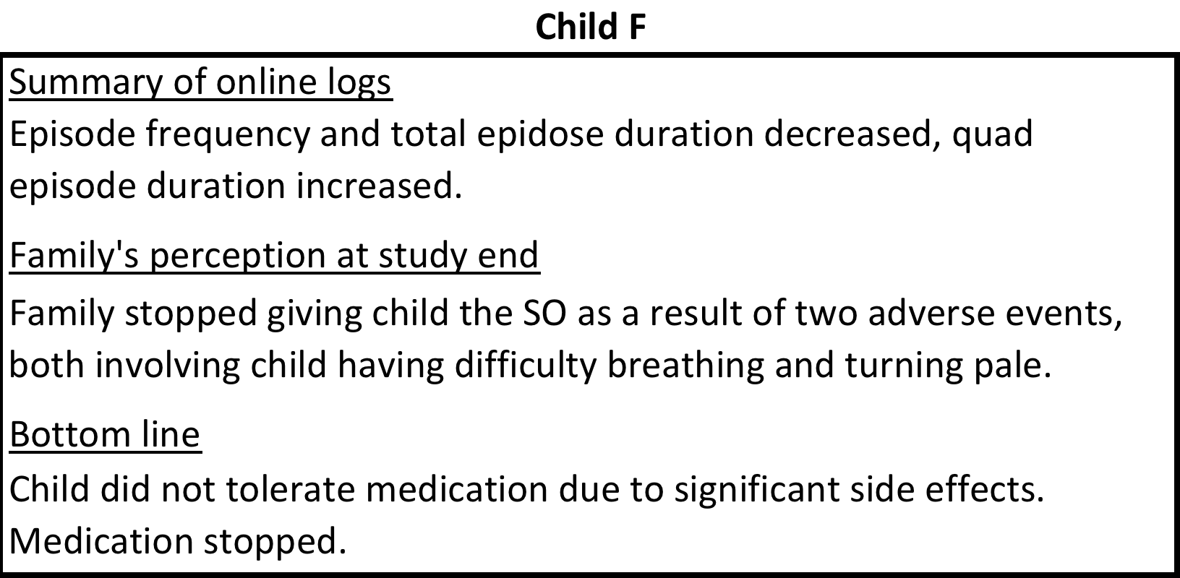
Results

Slide 28
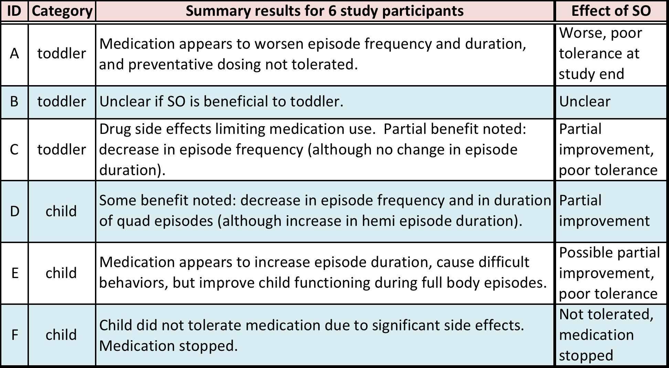
Results

Slide 29
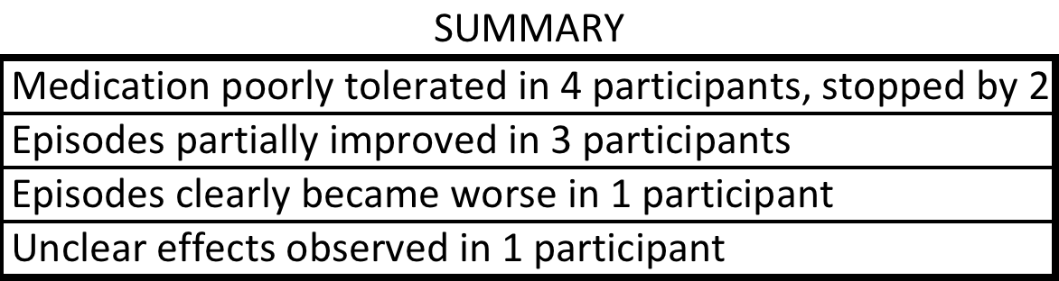
Results

Slide 30
Study conclusions
Challenging, time-consuming study, but important lessons learned about how to design future trials
Conflicting results are real, and reflect variability of types of spells in children, and their parents perception of how it impacts their function
SO appears to have a wide variety of effects in AHC
  Range of concerning side effects observed
    Difficulty breathing
    Desaturations
    Worsening of behaviors
    Excessive sleepiness
  No Change/Worsening/Partial improvement for some aspects
  SO may, in some cases, prove valuable to abort prolonged episodes under closely monitored conditions. The regimen and dosing used in this study may not be the most ideal; individualized studies in specific children using a single use IND model may be of additional benefit in enhancing knowledge of potential benefit/risk in AHC

Slide 31
Future directions
Need to better support families for participation in such studies; detailed information about use of other medications and strategies is critical in interpreting results
May use daily online AHC episode log for evaluation of other medications in the future; clearly, parents view different types of episodes differently, so using only episode duration or frequency seems to be inadequate based on families perceptions solicited during this study
Family input and participation in obtaining data is critical

Slide 32
Acknowledgements
Study participants and their families
Co-investigators:
Kathryn J. Swoboda, M.D.
Matthew T. Sweney, MD MS
Sandra P. Reyna, M.D.
Brian Katchan, MD
Kenneth Silver, MD
Joshua Magleby, PhD
Janiece L Pompa, Ph.D.
University of Utah team:
Abby Smart, RN
Whit Coleman, RN
Alina Brewer
Scott Claerhout, MS
Katherine Liu
Jenna Dodds, BS
Benjamin Chisum, BS

Slide 33
Funding
Alternating Hemiplegia of Childhood Foundation
Award Number UL1RR025763 and UL1RR025764 from the National Center for Research Resources

Slide 34
Thank you
Questions / comments

