Slide 1


Genetic Approaches to Rare Diseases:
What has worked and what may work for AHC
Erin L. Heinzen, Pharm.D, Ph.D
Center for Human Genome Variation
Duke University School of Medicine
July 22, 2011
e.heinzen@duke.edu

Slide 2
SCHIZOPHRENIA
EPILEPSY DISORDERS
RARE DISEASES/TRAITS
    AHC
    Undefined congenital disorders
    Primordial dwarfism
    Centenarians
    Exceptional memory
HIV RESISTANCE AND PROGRESSION
PHARMACOGENETICS

Slide 3
OUTLINE
NEXT-GENERATION SEQUENCING
    What is next-generation sequencing
    Calling variants from next-generation sequencing data
DETECTING DISEASE-CAUSING MUTATIONS IN RARE, SPORADIC DISEASES
    Case-control analyses
    TRIO analysis
    Identifying genetic mutations responsible for two, rare sporadic disease by sequencing TRIOs
STUDIES TO IDENTIFY GENETIC MUTATIONS RESPONSIBLE FOR AHC

Slide 4
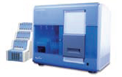
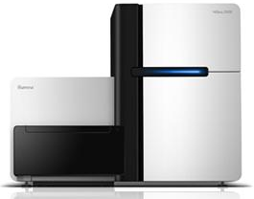

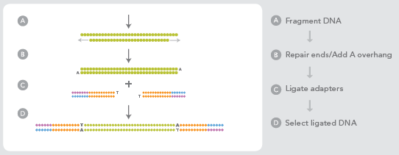
Next-generation sequencing

Slide 5
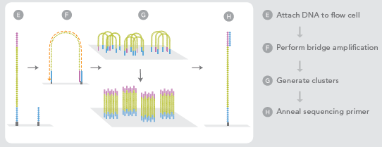
Next-generation sequencing

Slide 6
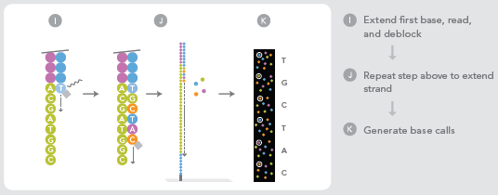
GTCAGTCTTTAAAGTCCCGAATTCGCCCAGGGTCAGTCTTTAAAGTCCCGAATTCGCCCAGGGTCAGTCTTTAAAGTCCCGAATTCGCCCAGGGTCAGTCTTTAAAGTCC
GTCAGTCTTTAAAGTCCCGAATTCGCCCAGGGTCAGTCTTTAAAGTCCCGAATTCGCCCAGGGTCAGTCTTTAAAGTCCCGAATTCGCCCAGGGTCAGTCTTTAAAGTCC
GTCAGTCTTTAAAGTCCCGAATTCGCCCAGGGTCAGTCTTTAAAGTCCCGAATTCGCCCAGGGTCAGTCTTTAAAGTCCCGAATTCGCCCAGGGTCAGTCTTTAAAGTCC
GTCAGTCTTTAAAGTCCCGAATTCGCCCAGGGTCAGTCTTTAAAGTCCCGAATTCGCCCAGGGTCAGTCTTTAAAGTCCCGAATTCGCCCAGGGTCAGTCTTTAAAGTCC
GTCAGTCTTTAAAGTCCCGAATTCGCCCAGGGTCAGTCTTTAAAGTCCCGAATTCGCCCAGGGTCAGTCTTTAAAGTCCCGAATTCGCCCAGGGTCAGTCTTTAAAGTCC
GTCAGTCTTTAAAGTCCCGAATTCGCCCAGGGTCAGTCTTTAAAGTCCCGAATTCGCCCAGGGTCAGTCTTTAAAGTCCCGAATTCGCCCAGGGTCAGTCTTTAAAGTCC
1 billion 114 bp fragments
GTCAGTCTTTAAAGTCCCGAATTCGCCCAGGGTCAGTCTTTAAAGTCCCGAATTCGCCCAGGGTCAGTCTTTAAAGTCCCGAATTCGCCCAGGGTCAGTCTTTAAAGTCC
GTCAGTCTTTAAAGTCCCGAATTCGCCCAGGGTCAGTCTTTAAAGTCCCGAATTCGCCCAGGGTCAGTCTTTAAAGTCCCGAATTCGCCCAGGGTCAGTCTTTAAAGTCC
GTCAGTCTTTAAAGTCCCGAATTCGCCCAGGGTCAGTCTTTAAAGTCCCGAATTCGCCCAGGGTCAGTCTTTAAAGTCCCGAATTCGCCCAGGGTCAGTCTTTAAAGTCC
GTCAGTCTTTAAAGTCCCGAATTCGCCCAGGGTCAGTCTTTAAAGTCCCGAATTCGCCCAGGGTCAGTCTTTAAAGTCCCGAATTCGCCCAGGGTCAGTCTTTAAAGTCC
GTCAGTCTTTAAAGTCCCGAATTCGCCCAGGGTCAGTCTTTAAAGTCCCGAATTCGCCCAGGGTCAGTCTTTAAAGTCCCGAATTCGCCCAGGGTCAGTCTTTAAAGTCC
GTCAGTCTTTAAAGTCCCGAATTCGCCCAGGGTCAGTCTTTAAAGTCCCGAATTCGCCCAGGGTCAGTCTTTAAAGTCCCGAATTCGCCCAGGGTCAGTCTTTAAAGTCC
GTCAGTCTTTAAAGTCCCGAATTCGCCCAGGGTCAGTCTTTAAAGTCCCGAATTCGCCCAGGGTCAGTCTTTAAAGTCCCGAATTCGCCCAGGGTCAGTCTTTAAAGTCC
GTCAGTCTTTAAAGTCCCGAATTCGCCCAGGGTCAGTCTTTAAAGTCCCGAATTCGCCCAGGGTCAGTCTTTAAAGTCCCGAATTCGCCCAGGGTCAGTCTTTAAAGTCC
GTCAGTCTTTAAAGTCCCGAATTCGCCCAGGGTCAGTCTTTAAAGTCCCGAATTCGCCCAGGGTCAGTCTTTAAAGTCCCGAATTCGCCCAGGGTCAGTCTTTAAAGTCC
GTCAGTCTTTAAAGTCCCGAATTCGCCCAGGGTCAGTCTTTAAAGTCCCGAATTCGCCCAGGGTCAGTCTTTAAAGTCCCGAATTCGCCCAGGGTCAGTCTTTAAAGTCC

Slide 7
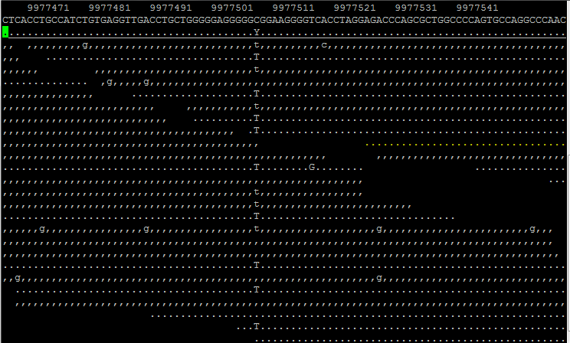
Genomic alignment of all the fragments and variant calling
SUBJECT 1
POSITION ALONG THE CHROMOSOME
REFERENCE GENOME SEQUENCE
ALIGNED SEQUENCING READS
SUBJECT IS A HETOZYGOTE FOR THIS VARIANT: ½ READS ARE THE SAME AS REFERENCE, ½ READS ARE DIFFERENT FROM THE REFERENCE

Slide 8
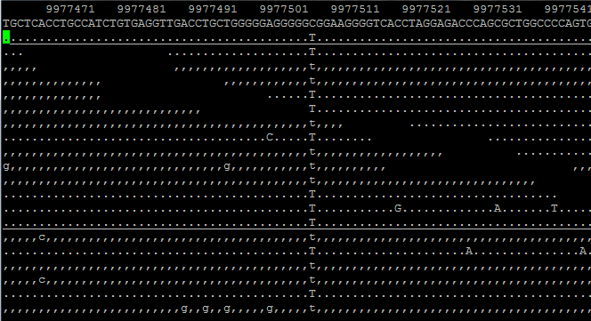
Genomic alignment of all the fragments and variant calling
SUBJECT 2
POSITION ALONG THE CHROMOSOME
REFERENCE GENOME SEQUENCE
ALIGNED SEQUENCING READS
SUBJECT IS A HOMOZYGOTE FOR THIS VARIANT: ALL READS ARE DIFFERENT FROM THE REFERENCE SEQUENCE

Slide 9
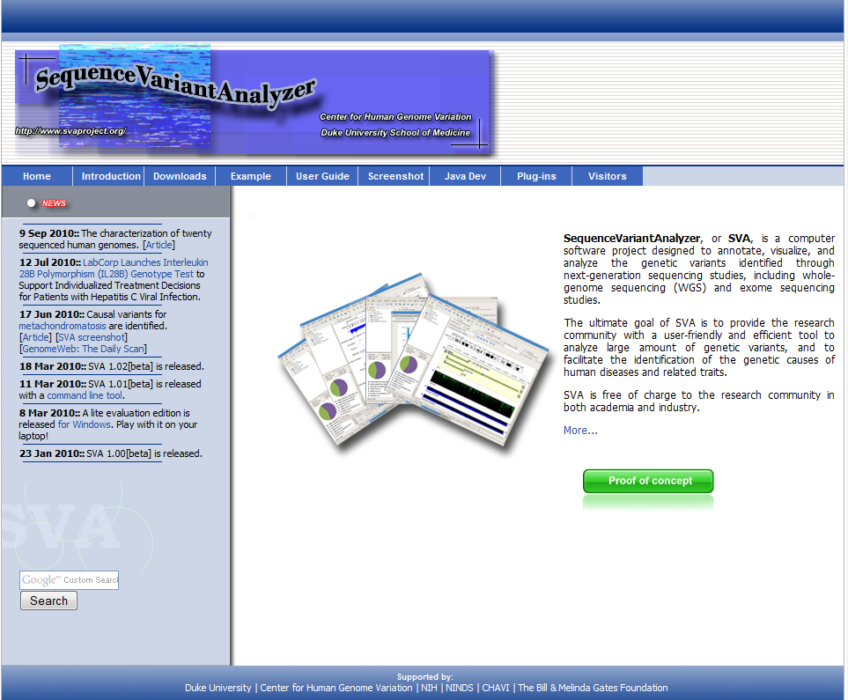
SequenceVariantAnalyzer, a dedicated software infrastructure to annotate, visualize, and analyze variants identified in whole genome or exome sequence data
http://www.svaproject.org/
Notes:
Dongliang Ge

Slide 10
Whole-genome and exome sequencing
CHGV
200 exomes and
50 genomes per month
Whole-genome sequencing
  sequencing of the entire genome
  Including all the protein-coding regions (exome) plus non-coding regions (regulatory regions)
Exome sequencing
  sequencing the protein-coding region of the genome (~1-2% of the genome)
        most of the mutations known to cause disease are located in the protein-coding region of the genome
        approximately 1/3 the price of whole-genome sequencing

Slide 11
Types of genetic variants
Single nucleotide substitutions
Indel (small insertions or deletions)
Structural variants
    Translocations
    Inversions
    Large insertions
    Large duplications and deletions
Micro- and mini-satellites
Highly accurate detection with NGS
Unreliably detected with NGS

Slide 12
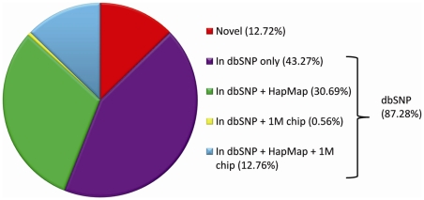

Number of variants in a genome
Pelak et al, PLoS Genetics 2010.
~3.5 million single nucleotide substitutions in each genome
~450K have never reported before in any public database
~50-100 likely functional that have never been seen in another sequenced individual

Slide 13
OUTLINE
NEXT-GENERATION SEQUENCING
    What is next-generation sequencing
    Calling variants from next-generation sequencing data
DETECTING DISEASE-CAUSING MUTATIONS IN RARE, SPORADIC DISEASES
    Case-control analyses
    TRIO analysis
    Identifying genetic mutations responsible for two, rare sporadic disease by sequencing TRIOs
STUDIES TO IDENTIFY GENETIC MUTATIONS RESPONSIBLE FOR AHC

Slide 14

Case-control study design
CASES
CONTROLS
OLIGOGENIC DISEASE
CHGV, 1000 exome sequenced controls and 200 whole-genome sequenced controls
MONOGENIC DISEASE
Disease-causing mutation
Disease-causing mutation in one gene
Disease-causing mutation in one gene
Disease-causing mutation in one gene
Benign genetic variant

Slide 15
TRIO study design
Searching for variants that are present in the affected offspring but absent in the unaffected parents, and absent in a control population.
3-5 likely functional “de novo” mutations
10-15 very rare, recessive functional variants

Slide 16
Success stories of finding a mutation responsible for a rare disease
Collaboration of the CHGV (Dr. Anna Need) with the Medical Genetics Department at Duke (Dr. Vandana Sashi)
Sequencing of patients with multiple congenital abnormalities with no known cause
TRIO sequencing approach
Sequenced 12 TRIOs in total

Slide 17
Patient 5
Confirmed de novo mutation in TCF4, a gene known to carry mutations responsible for Pitt Hopkins syndrome (PHS)
The patient did not have a diagnosis of Pitt Hopkins syndrome, but they did have some similar disorders
From sequencing the patient was able to receive a definitive diagnosis

Slide 18
Patient 11
A de novo variant was identified and confirmed in SCN2A, a sodium channel gene and was confirmed by Sanger sequencing.
The child presents with epilepsy, severe intellectual disabilities, minor dysmorphisms and hypotonia. Both de novo and inherited variants in SCN2A have been reported to cause a range of disorders, almost always including epilepsy and often severe intellectual disabilities.
The patient now has a genetic explanation for their disease

Slide 19
Fantastic technology! Why not sequence everyone with a disease?
COST!
Currently, if we were to sequence 34 TRIOs in the next 3-6 months it would cost
    $500K for whole-genome sequencing
    $200K for exome-sequencing

Slide 20
OUTLINE
NEXT-GENERATION SEQUENCING
    What is next-generation sequencing
    Calling variants from next-generation sequencing data
DETECTING DISEASE-CAUSING MUTATIONS IN RARE, SPORADIC DISEASES
    Case-control analyses
    TRIO analysis
    Identifying genetic mutations responsible for two, rare sporadic disease by sequencing TRIOs
STUDIES TO IDENTIFY GENETIC MUTATIONS RESPONSIBLE FOR AHC

Slide 21
Preliminary study AHC
We whole-genome sequenced three alternating hemiplegia patients and we compared them to 800 controls.
52 homozygous variants present in cases only, none seen in more than one case
461 heterozygous variants present in cases only, none seen in more than one patients

Slide 22
TRIO sequencing in AHC
In the next few months, we will exome-sequence three additional AHC patients and their parents to evaluate the de novo variants in the affected child
If no variants are detected, one or more TRIOs will be whole-genome sequenced

Slide 23


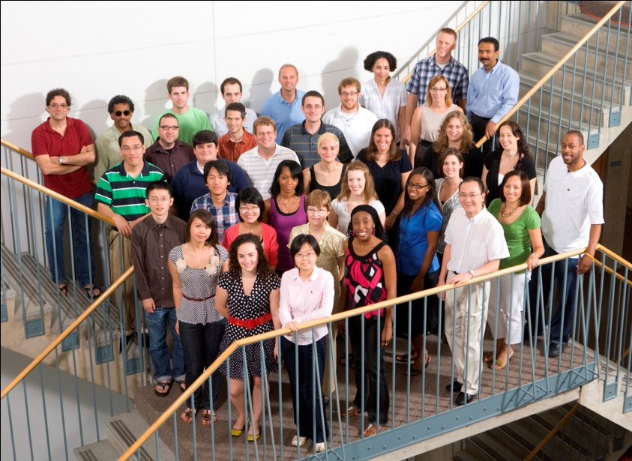


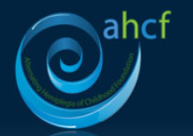
e.heinzen@duke.edu
Dr. Mohamad Mikati
Dr. Sanjay Sisodiya
Kristen Linney, RN
Nicole Baker, MS
Jeff Wuchich
Sharon Ciccodicola
Lynn Egan

