Slide 1
AHCF Family Meeting
Raleigh N.C., 22 – 24 July 2011

Slide 2
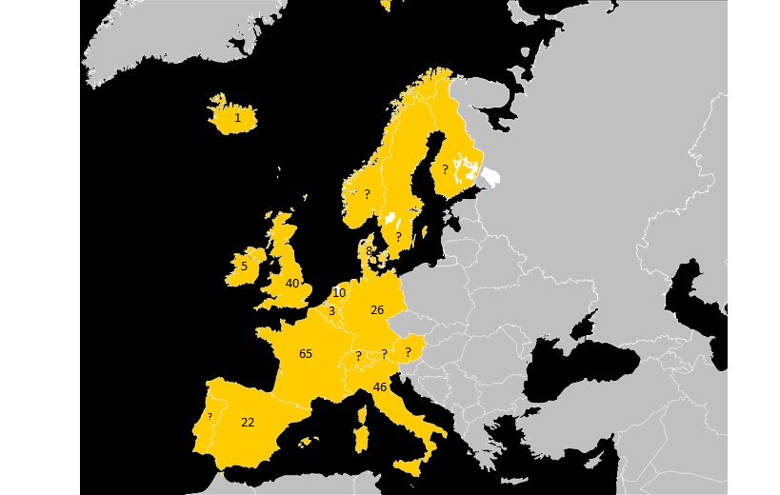
European update

Slide 3
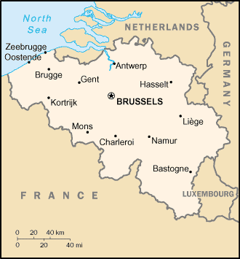
Belgium(Dutch speaking part of Belgium)
AHC persons: 3
Ages: 12, 17 and 30
Social activities: None

Slide 4
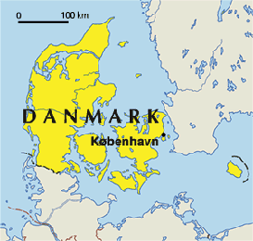
Denmark
AHC persons: 8
Social activities: Not much activity but a possible meeting in December
Website: www.ahckids.dk

Slide 5
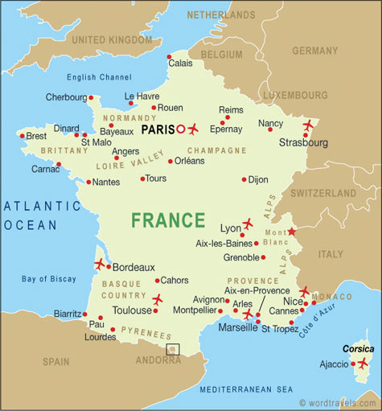
France
AHC persons: 65
In the association: 51
Social activities: Family meeting (2 days yearly) Greeting card + gift sent to every AHC child for their birthday. Newsletter (twice a year)
Fundraising: Tombola , donations, charity events, collecting about 30.000 Euros per year
Website: www.afha.org

Slide 6
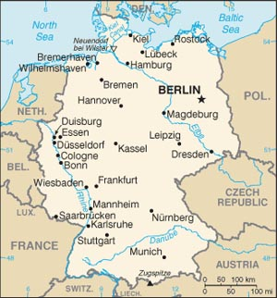
Germany
Number of AHC persons: 26
In the association: ?
Social activities: ?
Website: http://www.ahckids.de/

Slide 7
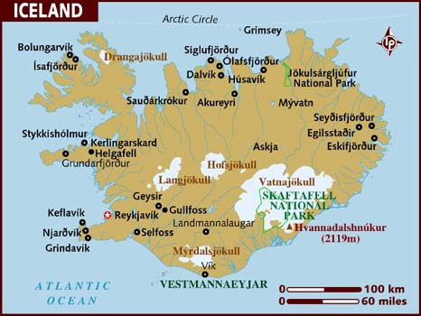
Iceland
Number of AHC persons: 1
In the association: 1
Social activities: Family meetings 365 days of the year☺
Fundraising: Reykjavik Marathon 20th August each year. Selling gift cards before X-mas – Fishing fly - Necklace – Paintings.
Website: www.ahc.is

Slide 8
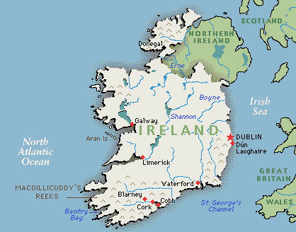
Ireland
Number of AHC persons: 5 - At least one patient in contact with Dr. Swoboda.
No association
No social activities
No website

Slide 9
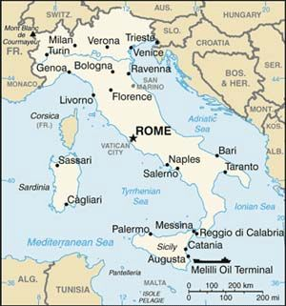
Italy
Number of AHC persons: 46 known AHC cases (mean age 19 years)
In the association:
110 official members mainly parents
and relatives of children affected by AHC
Website: www.aisea.org and
www.ibahc.org

Slide 10
Social activities
National Family Meeting (Rome, 20 – 21 March 2010)
Family Meeting Southern Area (Cosenza, 23 October 2010)
Family Meeting Northern Area (Milan, 6 November 2010)
Meeting of the Scientific Committee (Rome, 29 January 2011)
National Family Meeting (Rome, 26 – 27 March 2011)
Distribution of brochures, medical articles and information about AHC
Participation to Scientific and Medical Congress and sponsorship of informative sessions about AHC
Organization of Family meetings and medical/scientific workshops
«I like to run and play»
Advertising spot to have broadcasted on the radio and TV channels, local and national

Slide 11



“White book” for Alternating hemiplegia
Publication of the White Book for understanding and managing Alternating Hemiplegia (in Italian, in English and in Spanish by the association AESHA)
Publication of the National Guidelines for the assistance of the persons affected by AHC and of their families

Slide 12
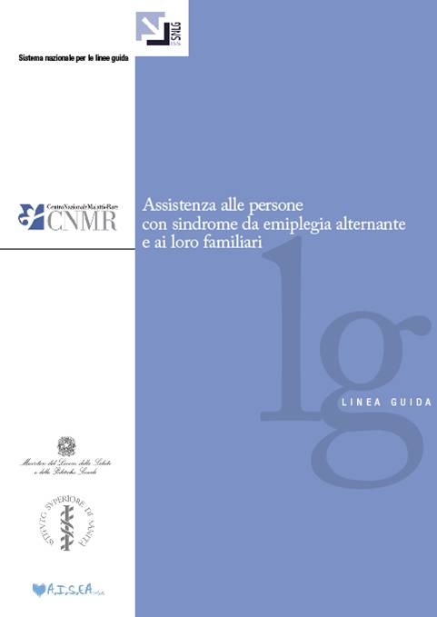
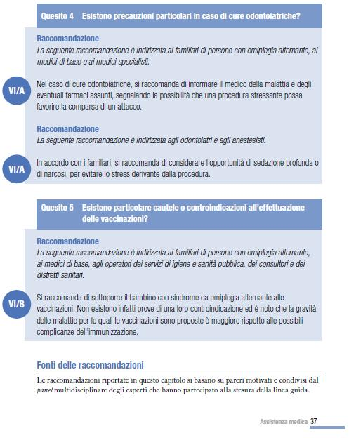
Guidelines for Alternating Hemiplegia
Guidelines for the assistance to the persons affected by Alternating Hemiplegia and their families
(diagnosis, treatment, management of the attacks, rehabilitation, health and social services, school attendance, adult life)
Published by:
Italian Ministry of Health
National Institute of Health
A.I.S.EA Onlus
http://www.snlg-iss.it/en_news_gl_alternating_hemiplegia

Slide 13
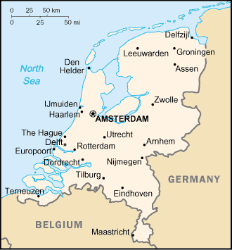
The Netherlands
Number of AHC persons: 9-10 Dutch children) Ages 3 to 21
7 in the association
Social activities:
No special activities at this moment.
Website: http://www.ahckids.nl/

Slide 14
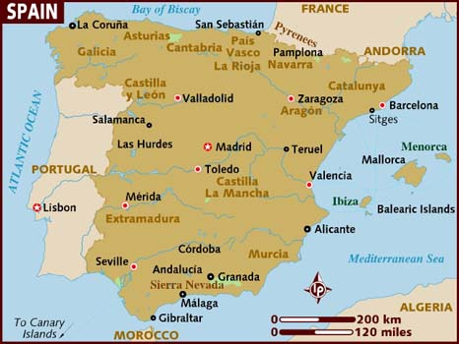
Spain
Number of AHC persons: 22
9 are involved with the association.
Social activities: Annual meetings
Website: http://www.aesha.org/

Slide 15
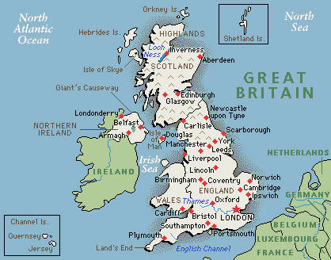
United Kingdom
Number of AHC persons: 40
In the association: 20
Social activities: family meeting once a year,
no other activities planed.
Website: http://ahcuk.co.uk/

Slide 16
Other countries in Europe
There are known AHC cases in Finland, Sweden and Norway
Other western Europe countries have no associations that we know of.
Eastern Europe ?

Slide 17
Various organisations
European Network for Research on Alternating Hemiplegia (ENRAH) http://www.enrah.net/
Eurordis – The voice of rare diseases in Europe
http://www.eurordis.org/
nEuroped - European Network on Rare Pediatric Neurological Diseases http://www.neuroped.eu

Slide 18
Combined European projects
Article in Brain http://brain.oxfordjournals.org/
European/Nord Projects:
Eurordis webpage www.rarediseasecommunities.org

Slide 19

Siggi Johannesson www.ahc.is

