Slide 1



ALTERNATING HEMIPLEGIA OF CHILDHOOD
Kenneth Silver md
University of Chicago
Comer Childrens Hospital

Slide 2
AHC: Classical Diagnostic Criteria
Onset of symptoms before 18 mo of age
Repeated attacks of hemiplegia involving either side of the body
Other paroxysmal disturbances including tonic or dystonic spells, oculomotor abnormalities, and autonomic phenomena during bouts in isolation
Episodes of bilateral hemiplegia or quadriplegia as generalization of a hemiplegic episode or bilateral from the beginning
Immediate disappearance of symptoms upon sleeping, which later may resume after waking
Evidence of developmental delay and neurologic abnormalities including choreoathetosis, dystonia, or ataxia

Slide 3
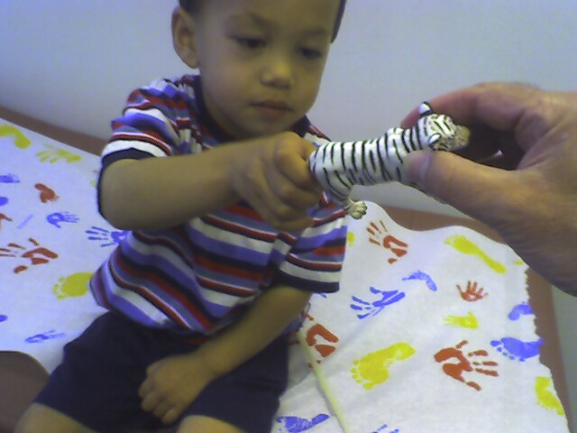
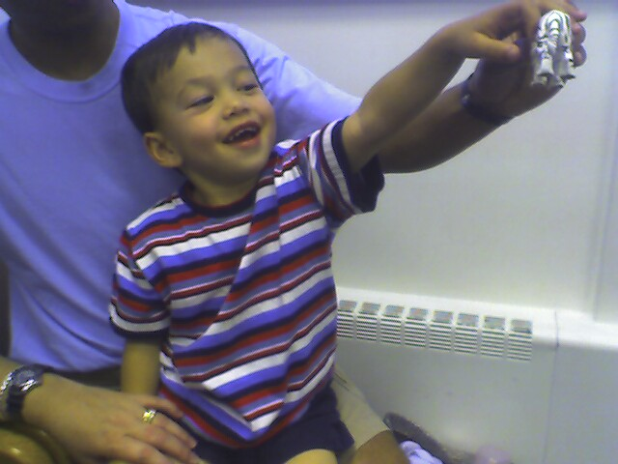

Slide 4
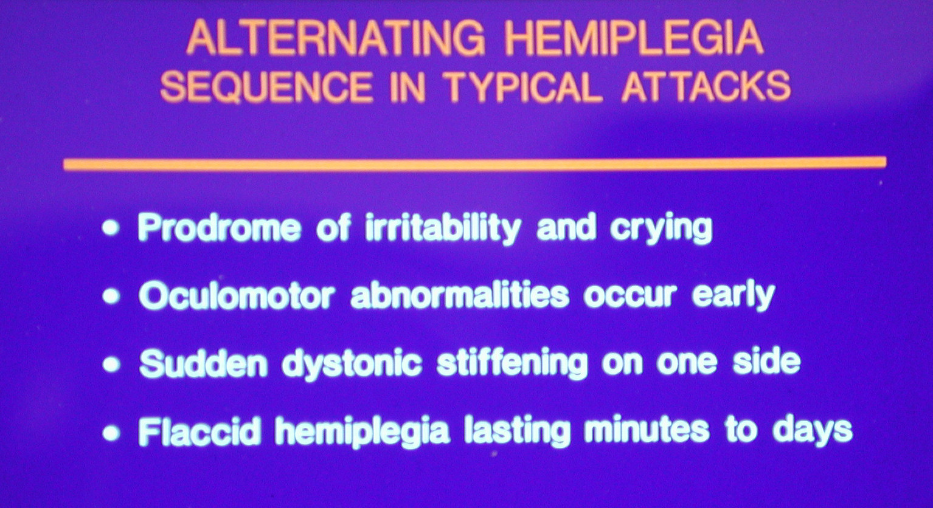

Slide 5
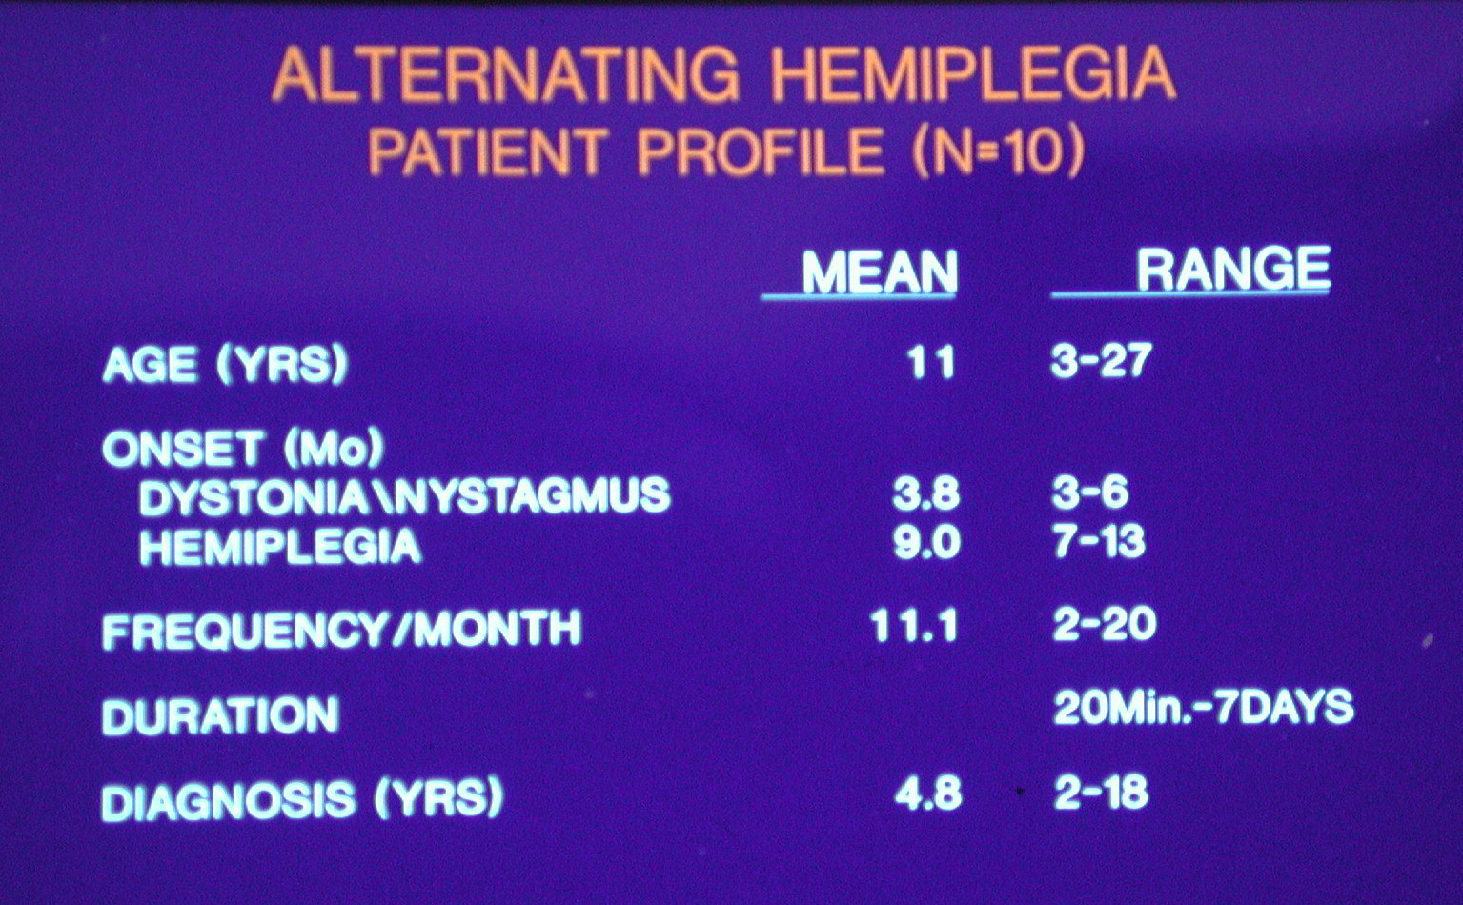

Slide 6
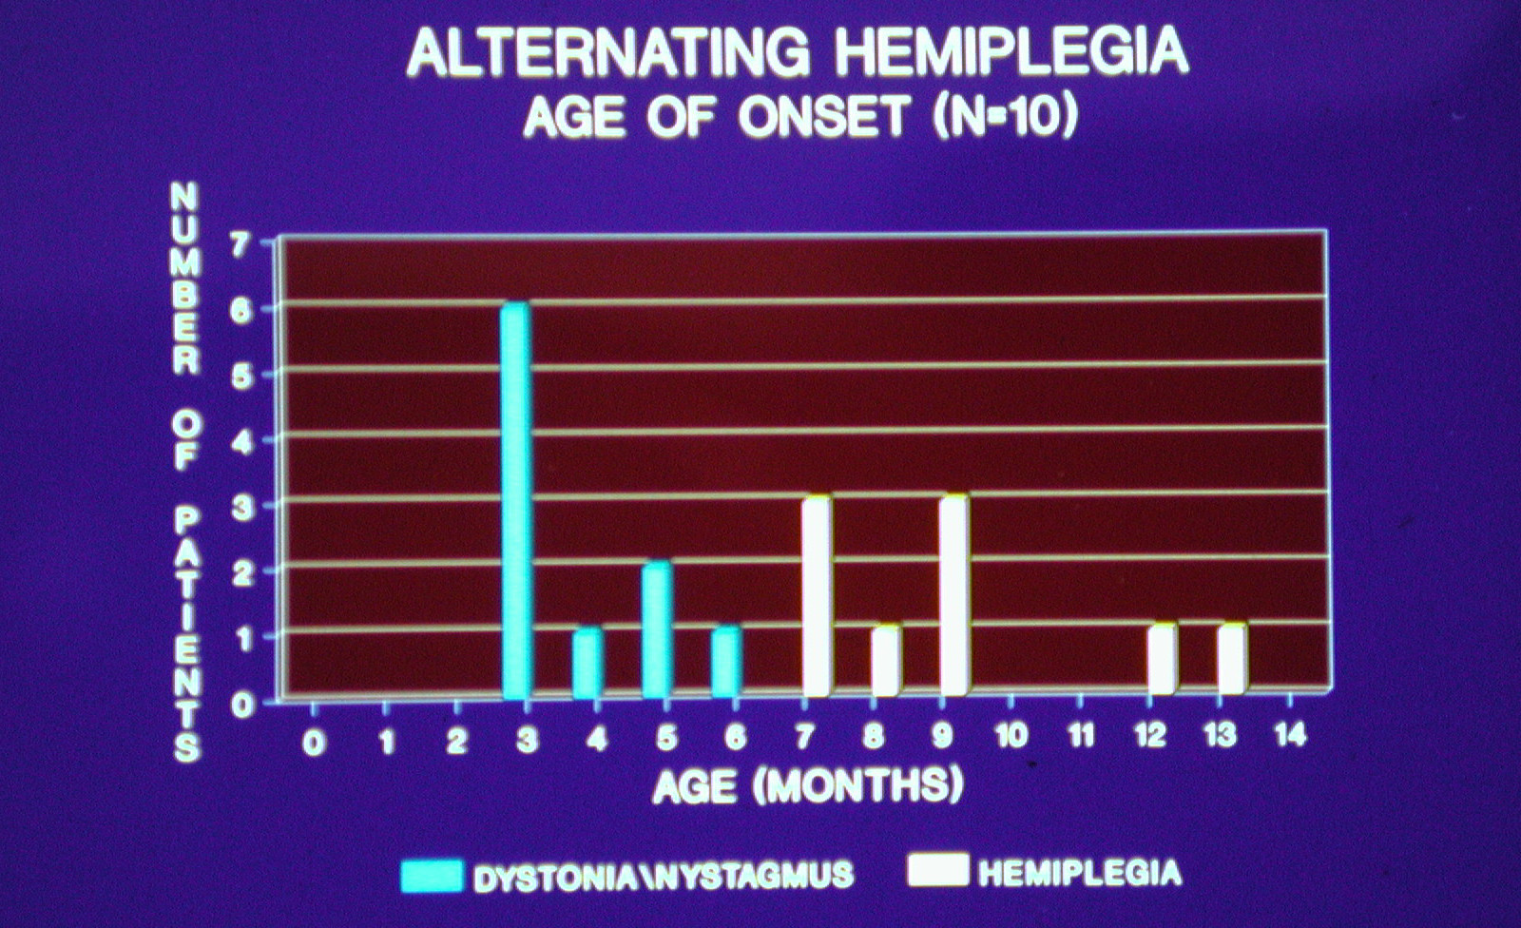

Slide 7
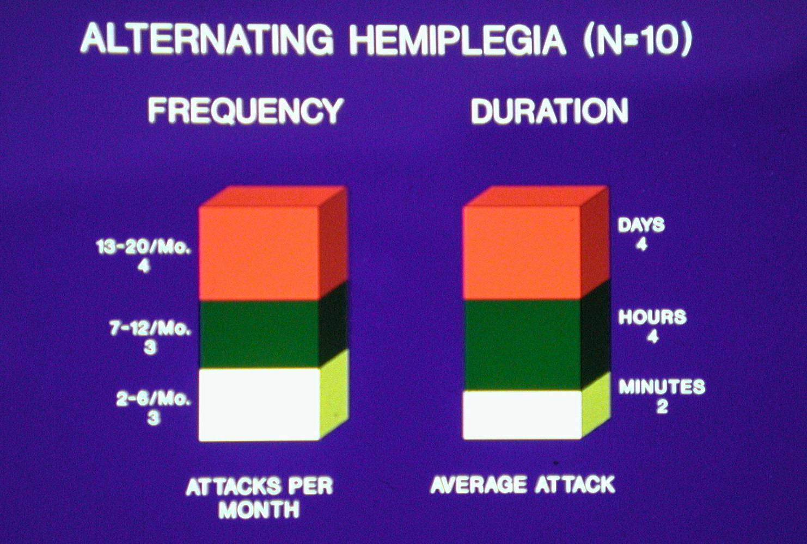

Slide 8
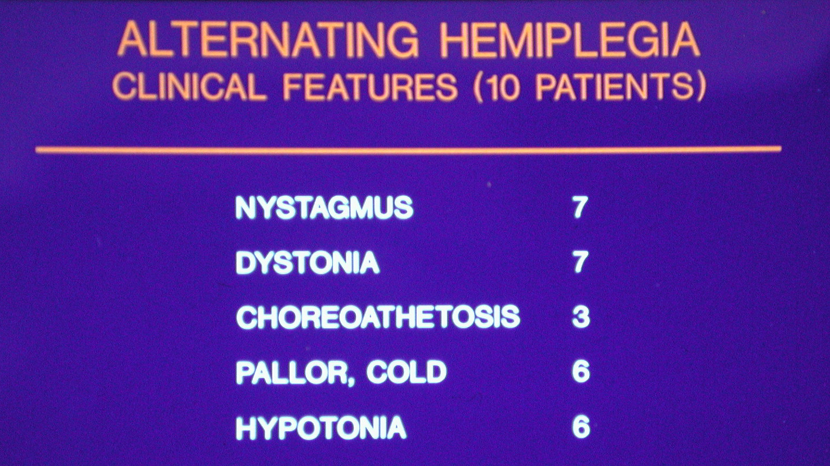

Slide 9
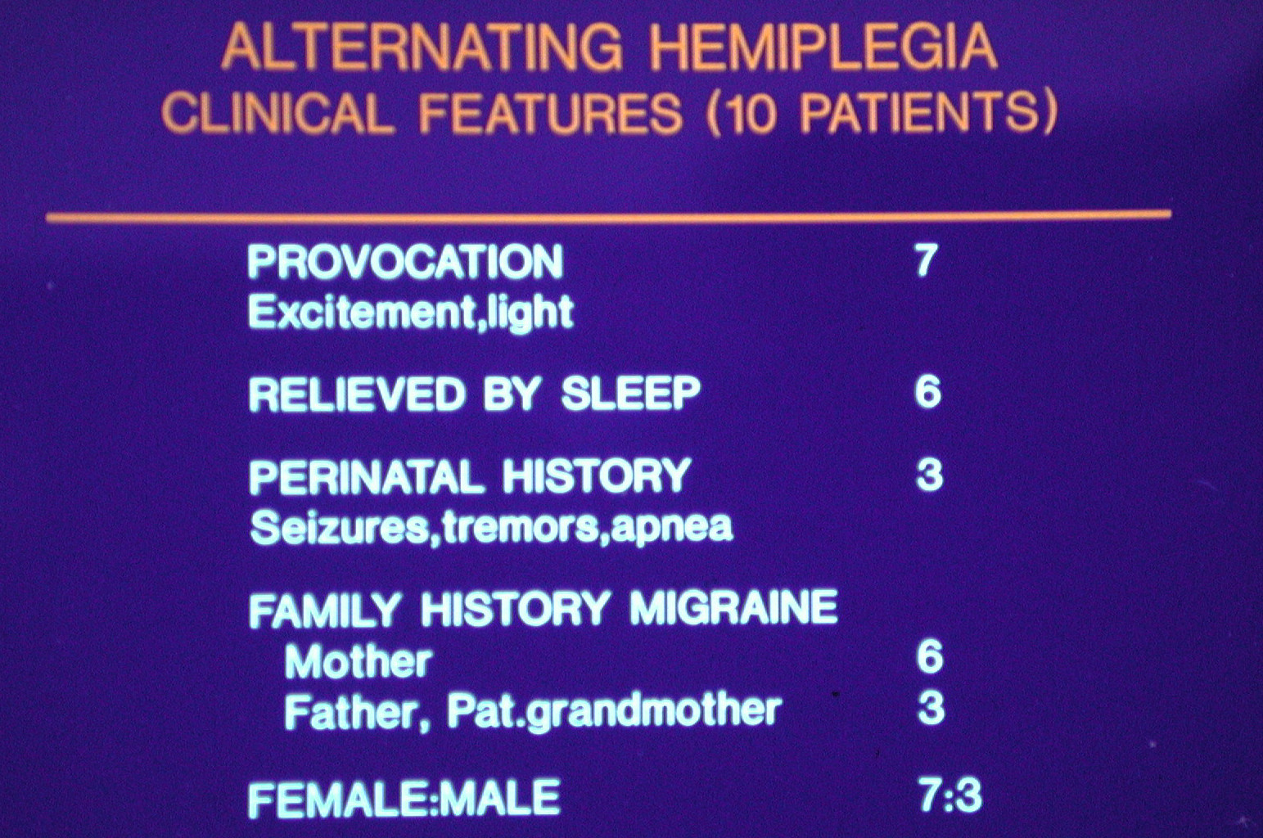

Slide 10
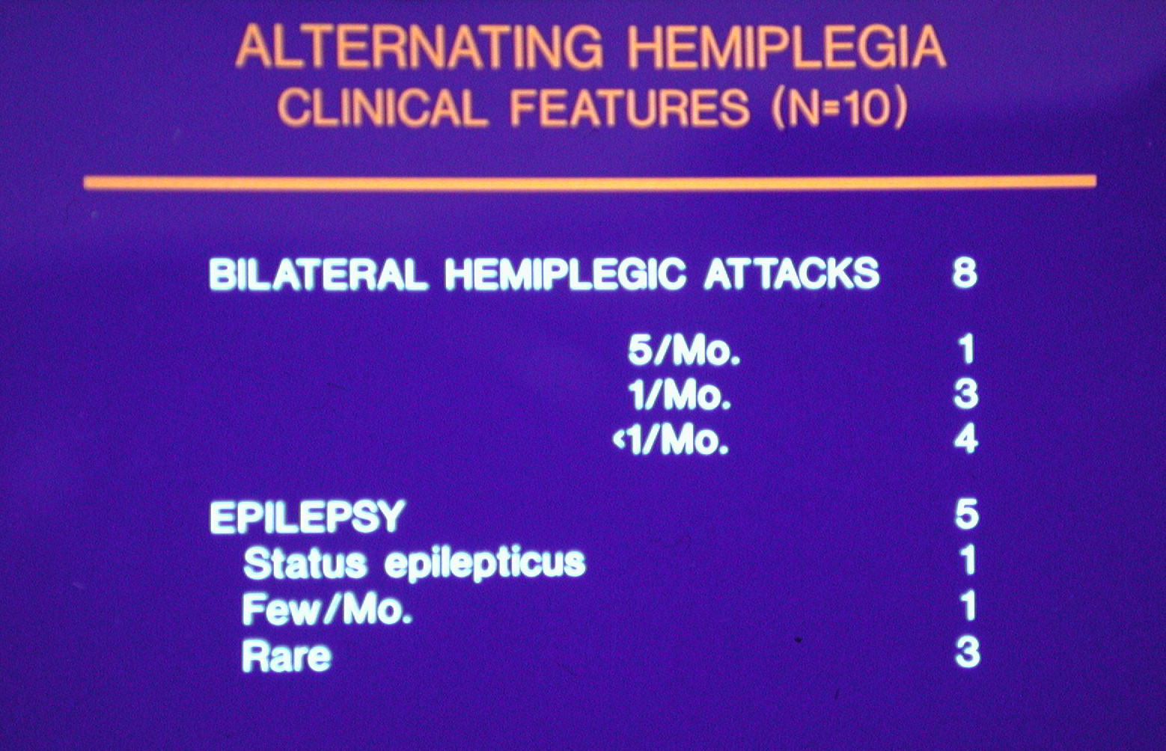

Slide 11
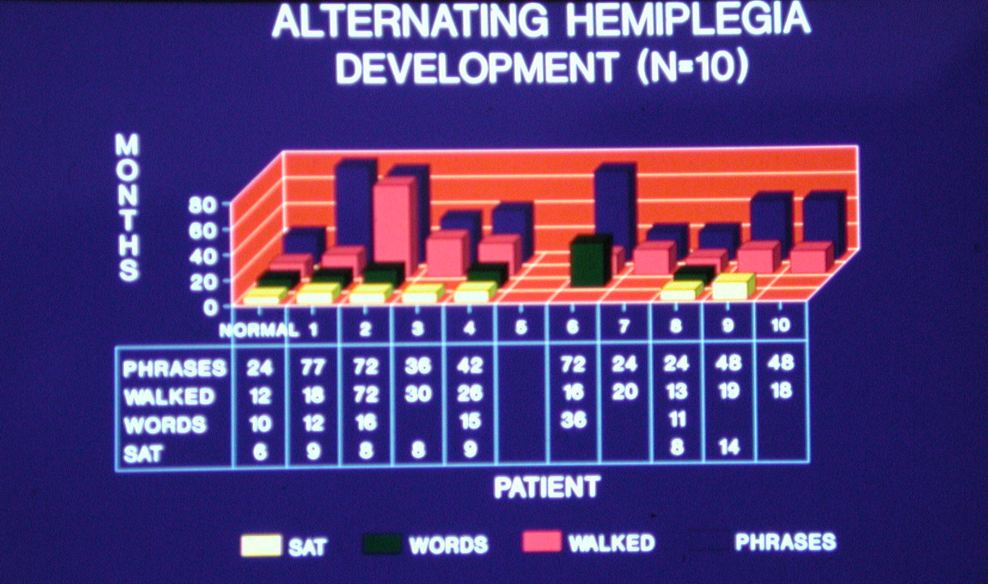

Slide 12
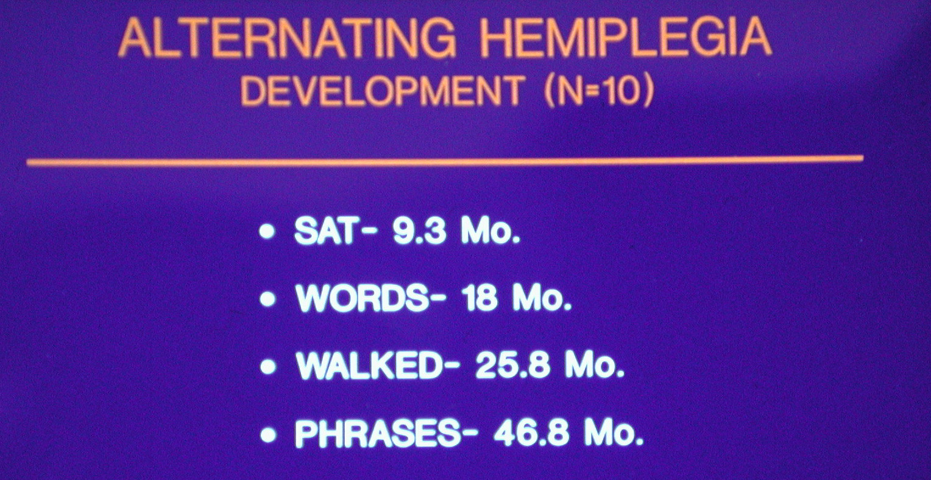

Slide 13
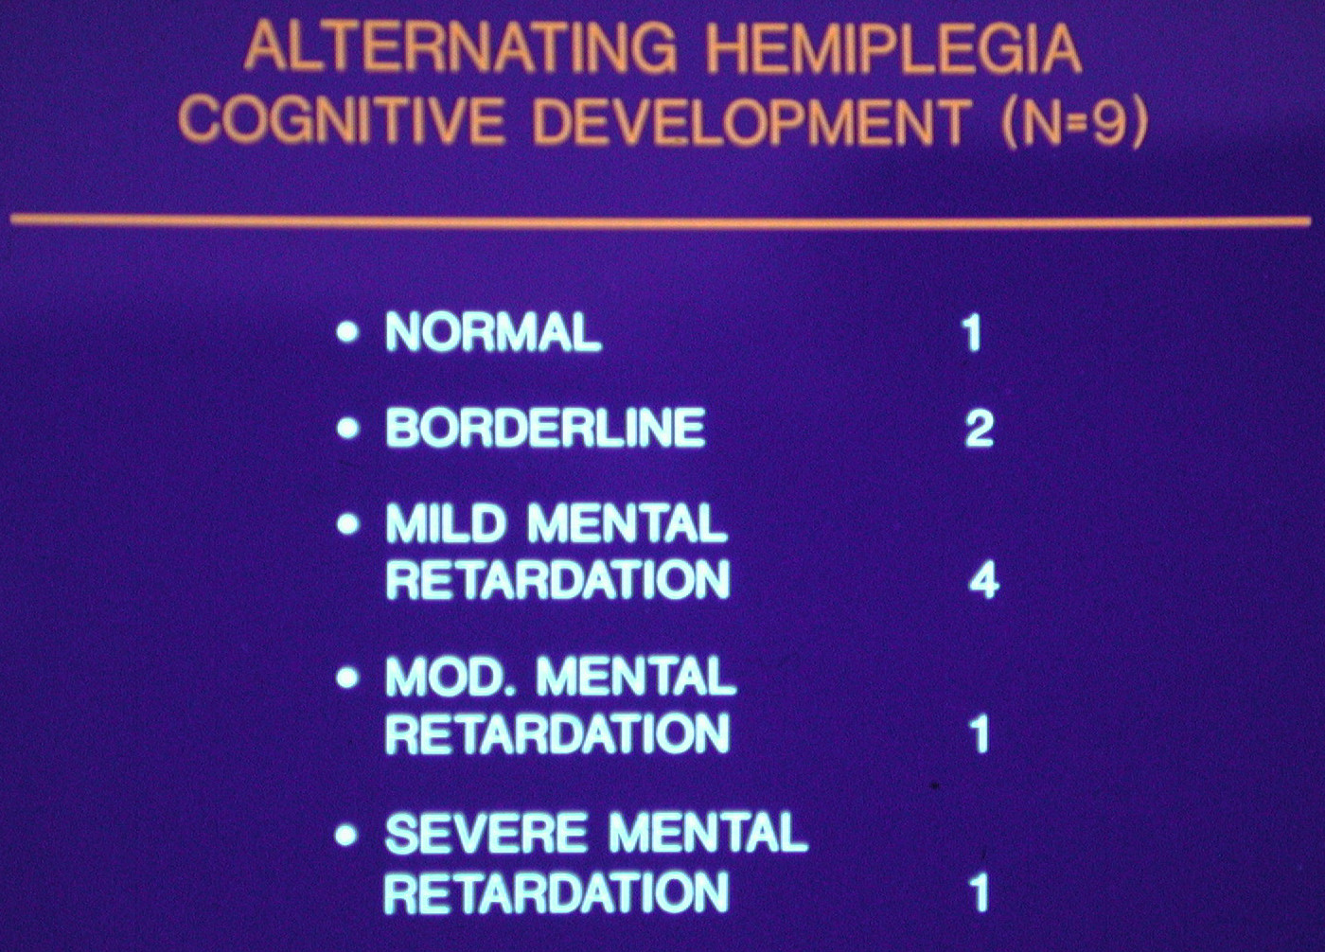

Slide 14
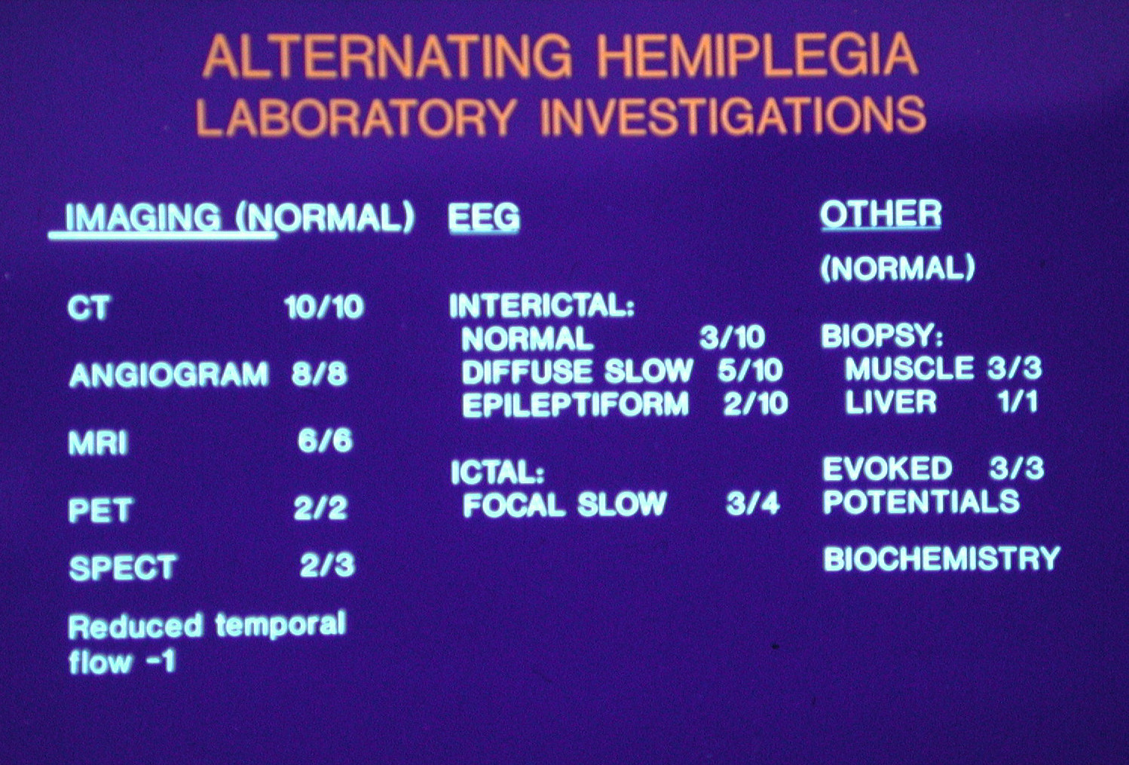

Slide 15

Alternating Hemiplegia of Childhood:
Early Characteristics and Evolution of a
Neurodevelopmental Syndrome
Matthew T. Sweney, Kenneth Silver, Marion Gerard-Blanluet, Jean-Michel Pedespan
Francis Renault, Alexis Arzimanoglou, Mylynda Schlesinger-Massart, Aga J. Lewelt,
Sandra P. Reyna and Kathryn J. Swoboda
Pediatrics 2009;123;e534-e541

Slide 16
Alternating Hemiplegia of Childhood: Clinical Features N=103
Data Base: 172 patients with episodic hemiplegia
Adequete records 132
Excluded atypical cases: 14 onset after 18 months old
Other Syndromes: 15 – FHM 2, BFNAHC 3
Leaving 103 cases
56 M: 47 F
Mean Age onset Dystonia and Hemiplegia 6.5 months
Abnormal eye movements 2.4 months (32% @ birth)
Apnea or respiratory distress in 24 %
Color and/or temperature changes in 58%
Hemiplegic spells lasting 1day to 3 weeks in 38%
Average time to diagnosis 36 months

Slide 17
Alternating Hemiplegia of Childhood: Clinical Features N=103
Epilepsy:
Generalized Seizures in 43%
Mean age of onset of seizures 69 months(+/- 58)
Seizure onset after age 10 years in 23%
Ataxia 5%
Cognitive impairment present in 96/96
Usually mild to moderate range
Detailed neuropsychological testing;
Shows wide variability
WISC;
FSIQ 62.5 (+/_14), VIQ 69.2 (+/_16), PIQ 63.7(+/_15)

Slide 18
Age of Onset of Symptoms N=103
Pediatrics 2009;123:e534–e541

Slide 19
Reported Triggers in AHC
Category Cases Reporting,% Examples
Environmental stress 75 Temperature extremes,
crowds,odors, irregular sleep
Water exposure 61 Bathing, swimming shampooing
Specific physical activities 50 Exercise, playground swing
Lighting 47 Sunlight, fluorescent bulbs
Foods 10 Chocolate, food dyes
Pediatrics 2009;123:e534–e541

Slide 20
Investigations:
MRI:
Normal 54/69
Abnormalities; isolated cerebral atrophy (3),
cerebellar atrophy (1), mesial temporal sclerosis(2)
EEG:
83 cases;
No epileptiform; 42 cases, background slow 21 cases
Interictal focal sharp waves 12 cases
Ictal hemiplegia slowing 15 cases

Slide 21
Investigations:
SPECT 36 cases hypometabolism 5
PET 33 cases hypometabolism 5
Cerebral Angiogram normal in all 25
Muscle skin biopsy 38 cases , 37 normal
M. Sasaki et al.
/ Brain & Development
31 (2009) 20–26

Slide 22
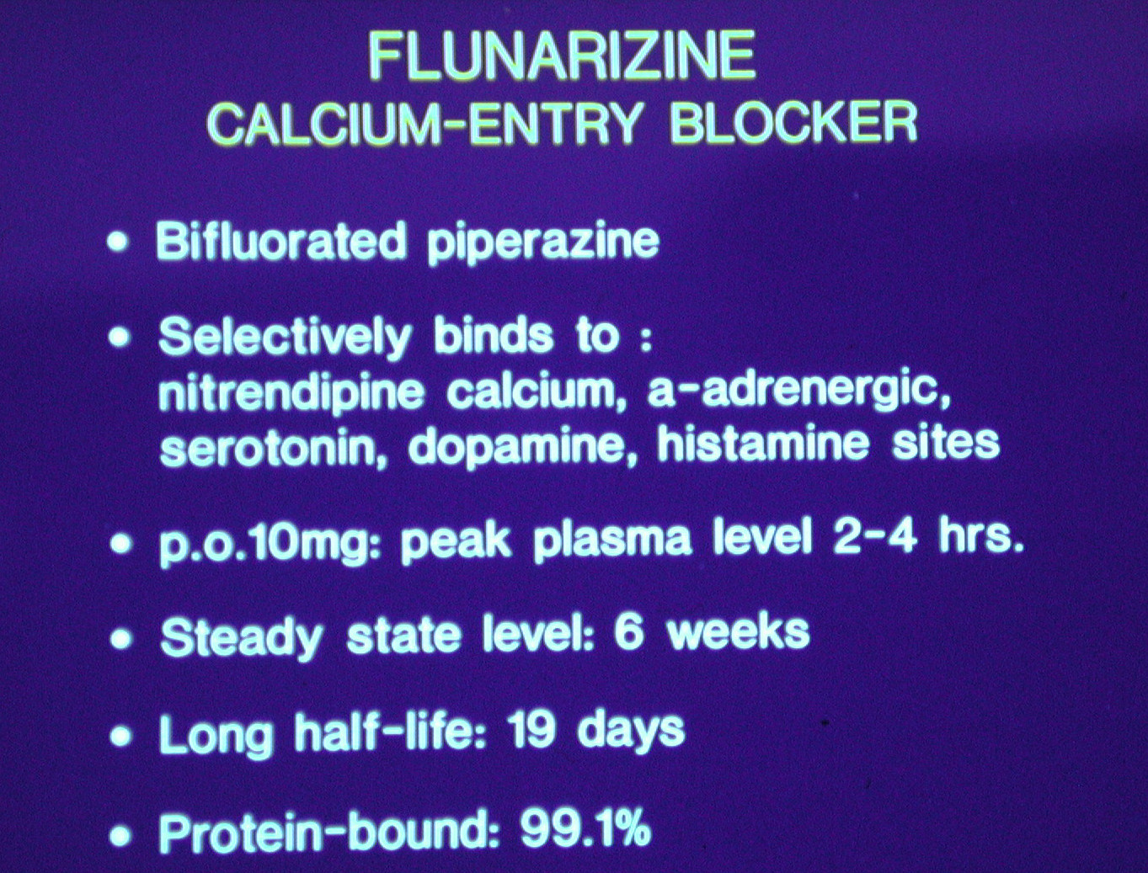

Slide 23
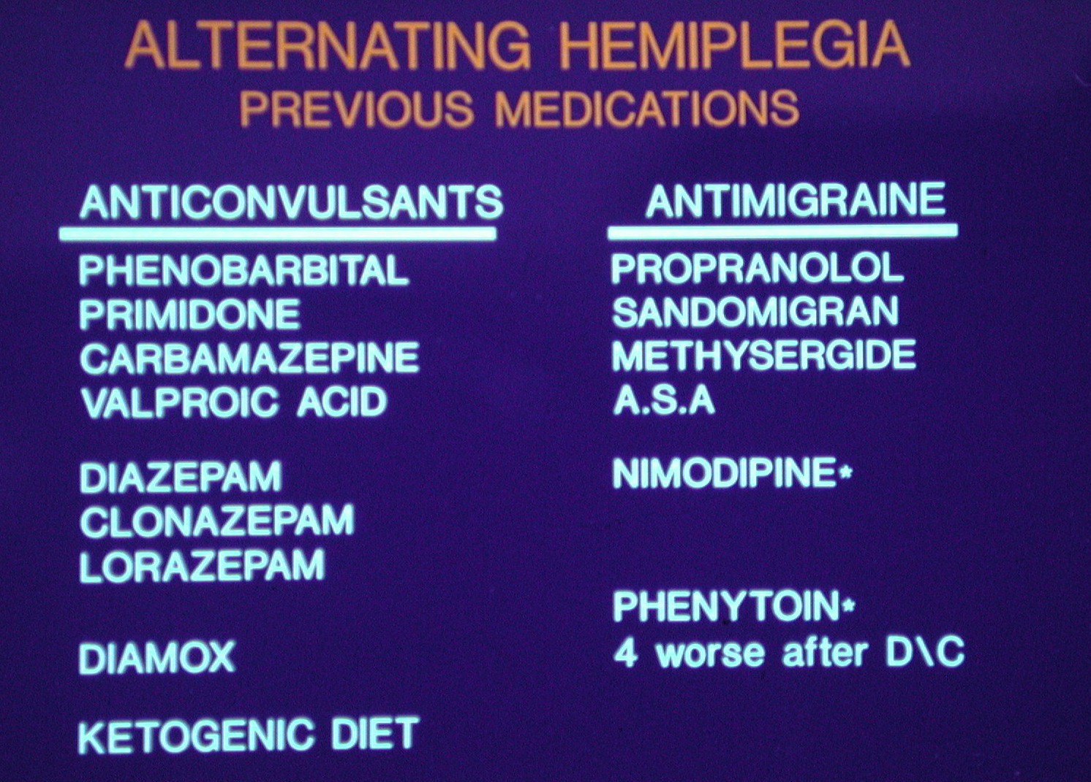

Slide 24
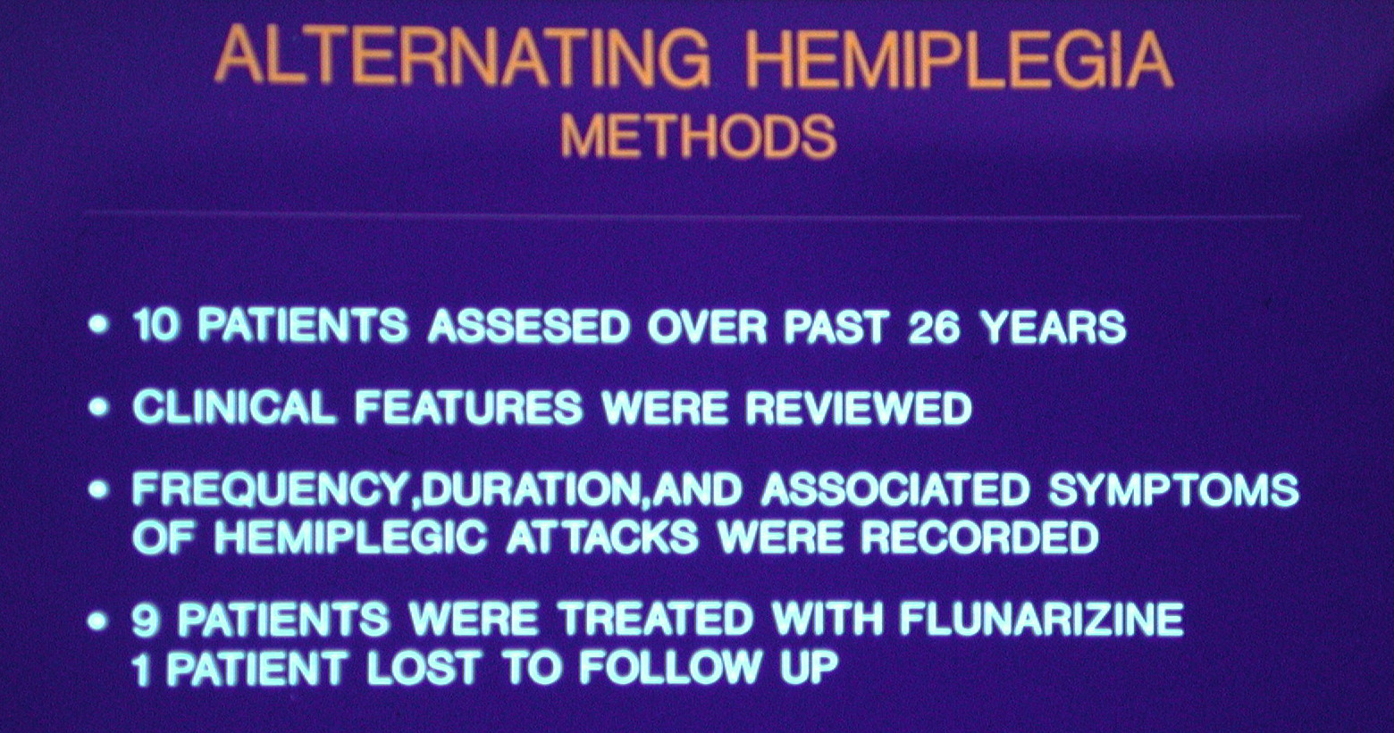

Slide 25
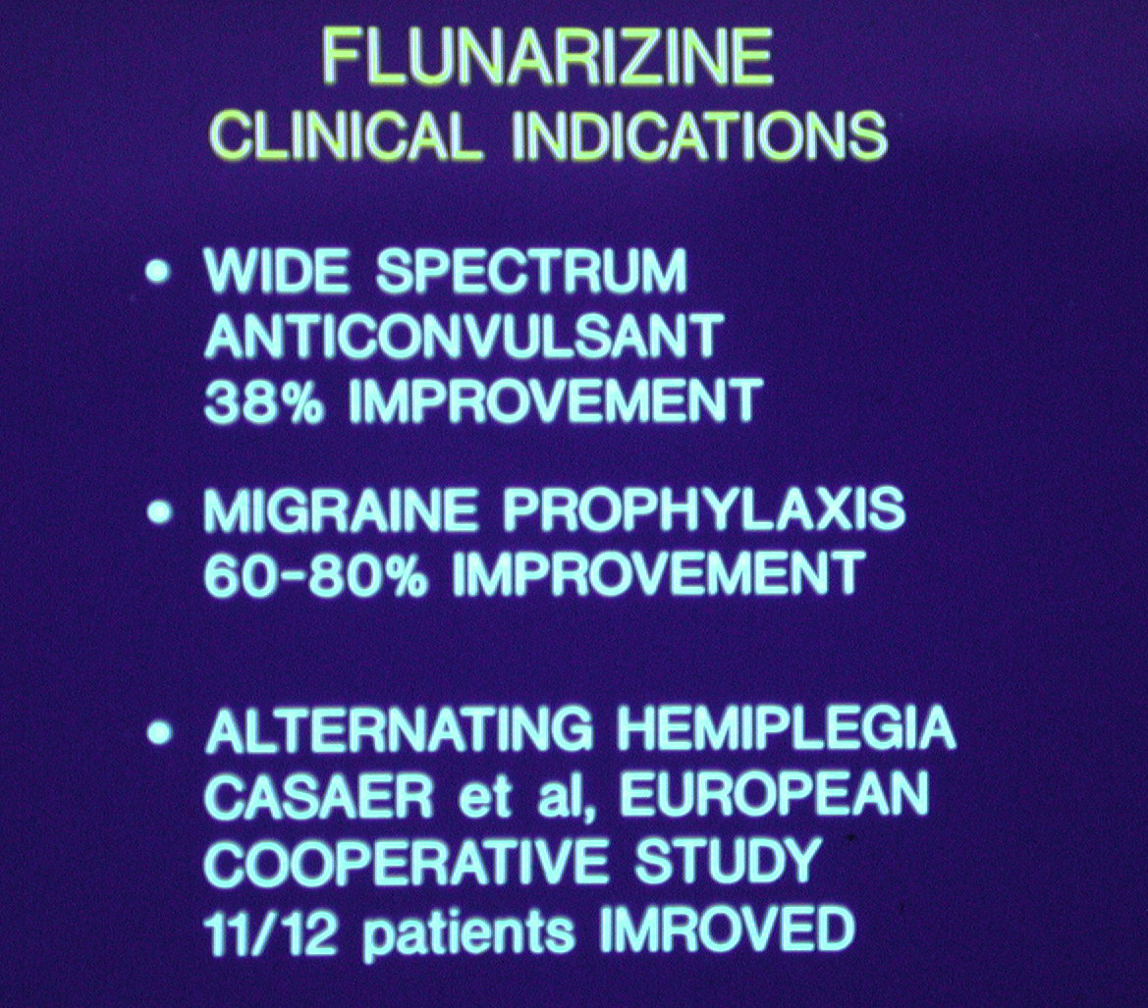

Slide 26
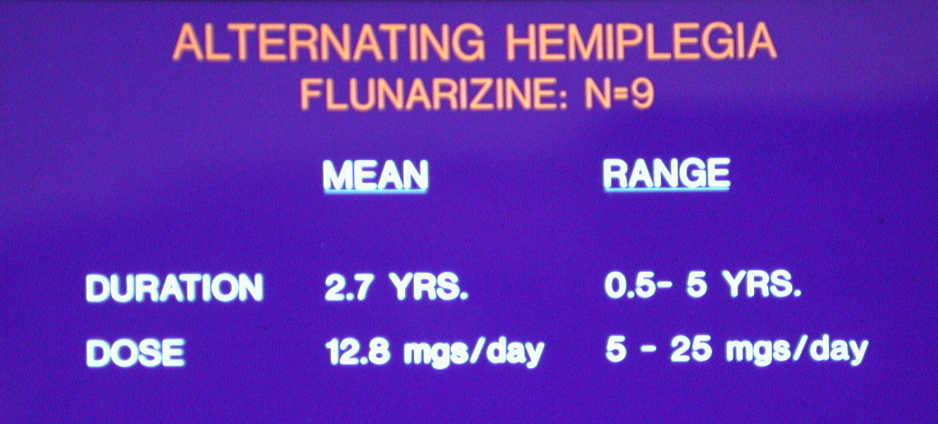

Slide 27
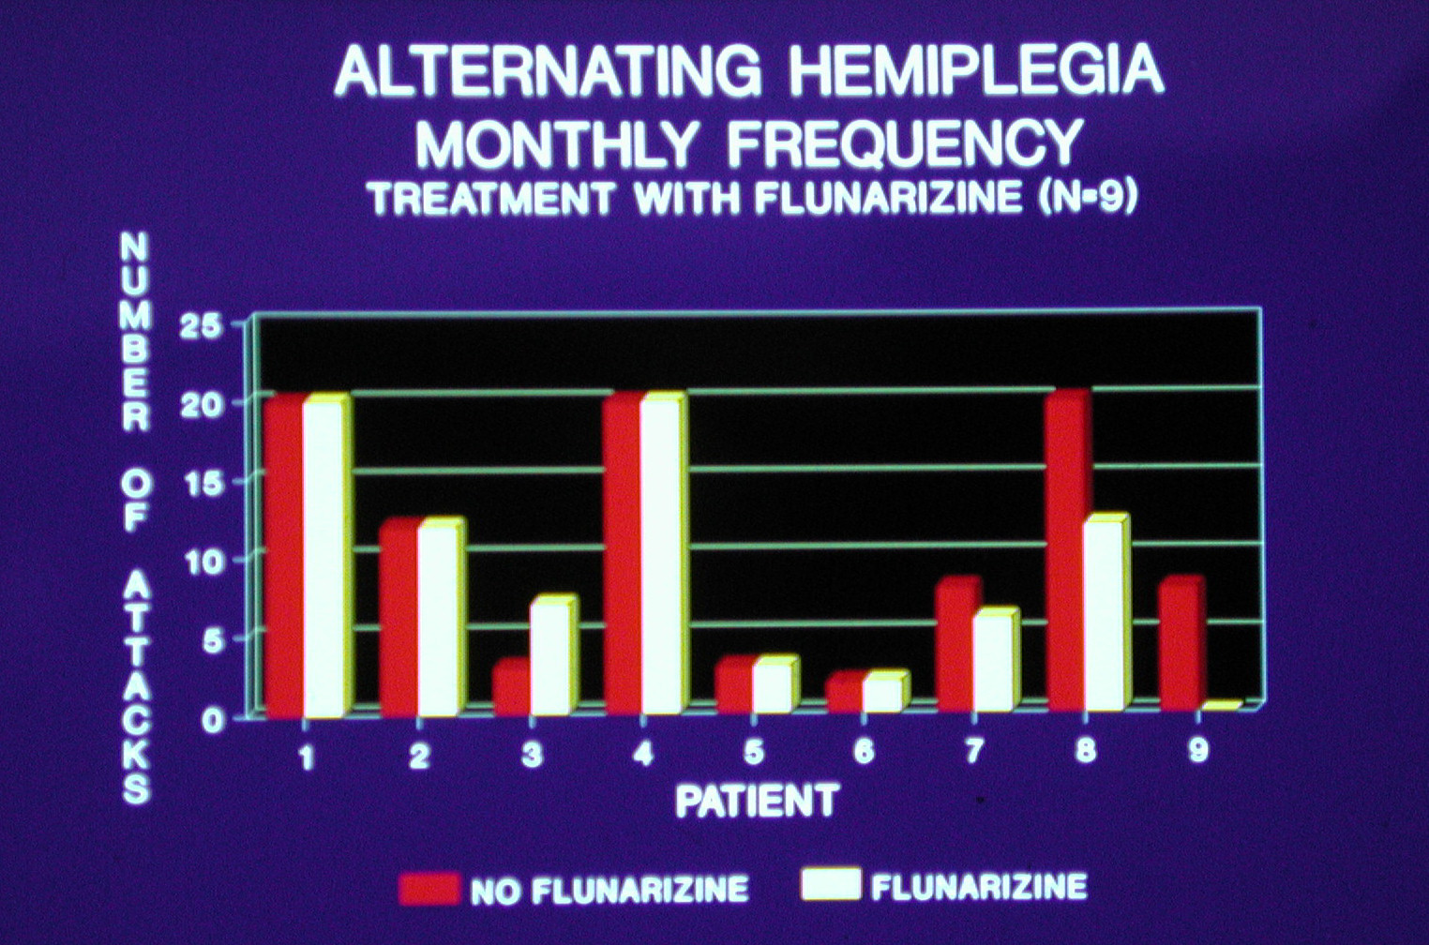

Slide 28
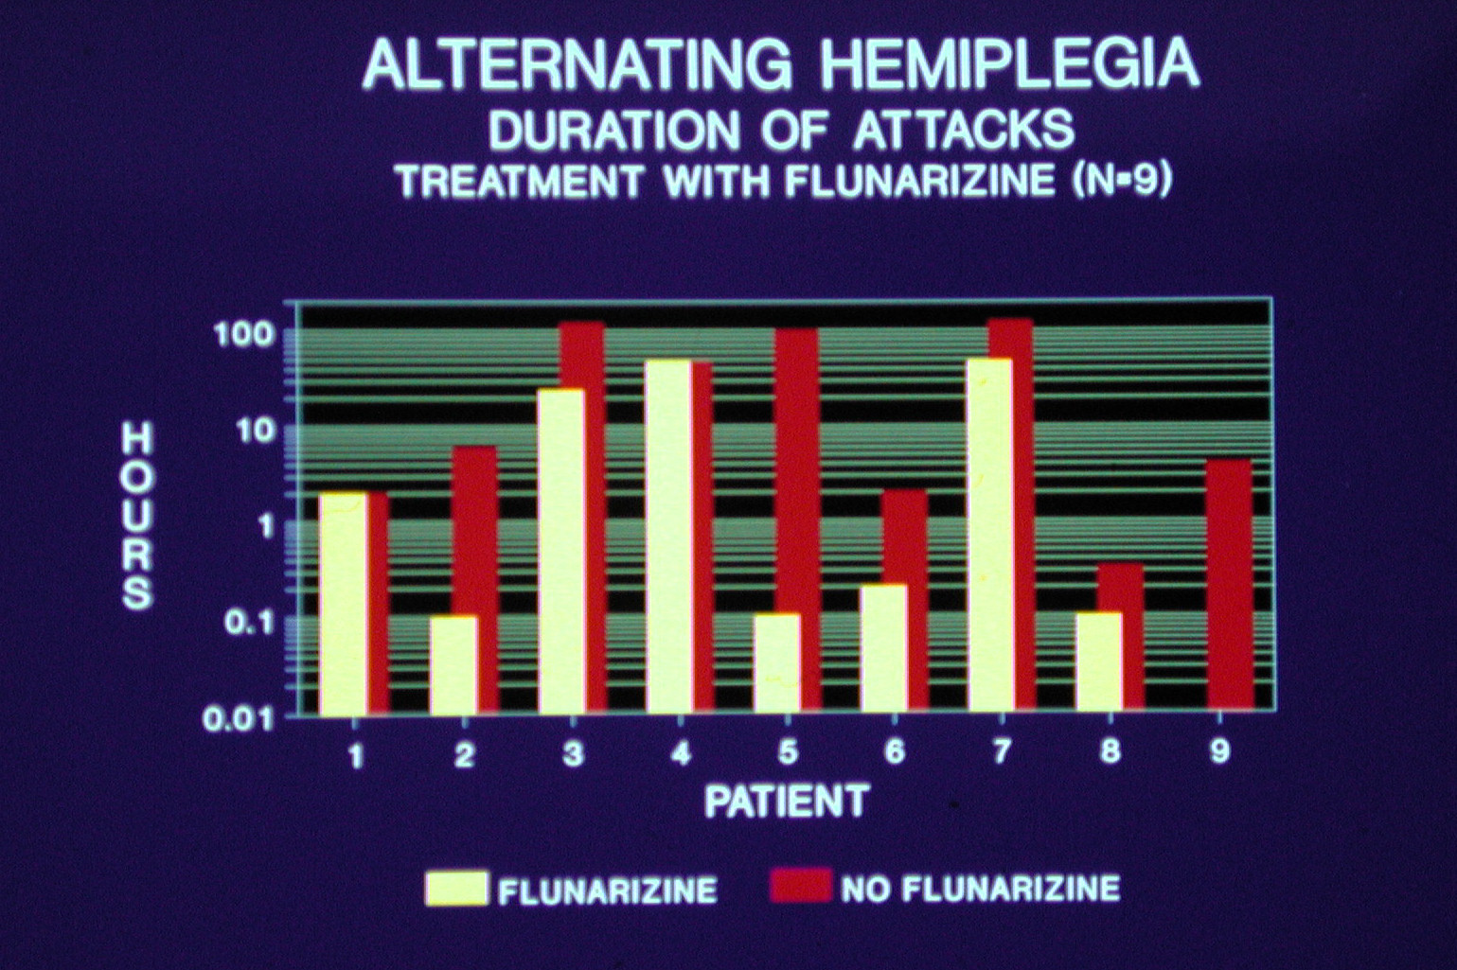

Slide 29
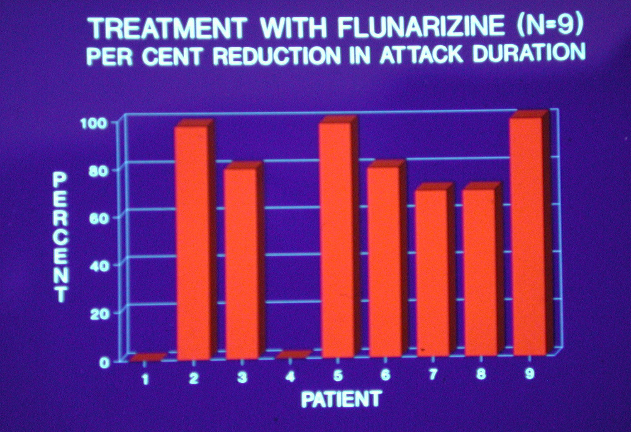

Slide 30
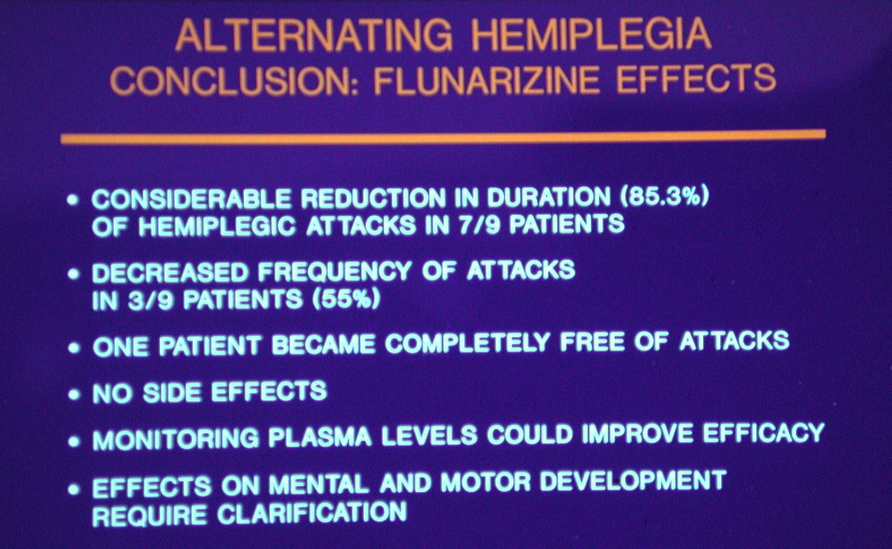

Slide 31
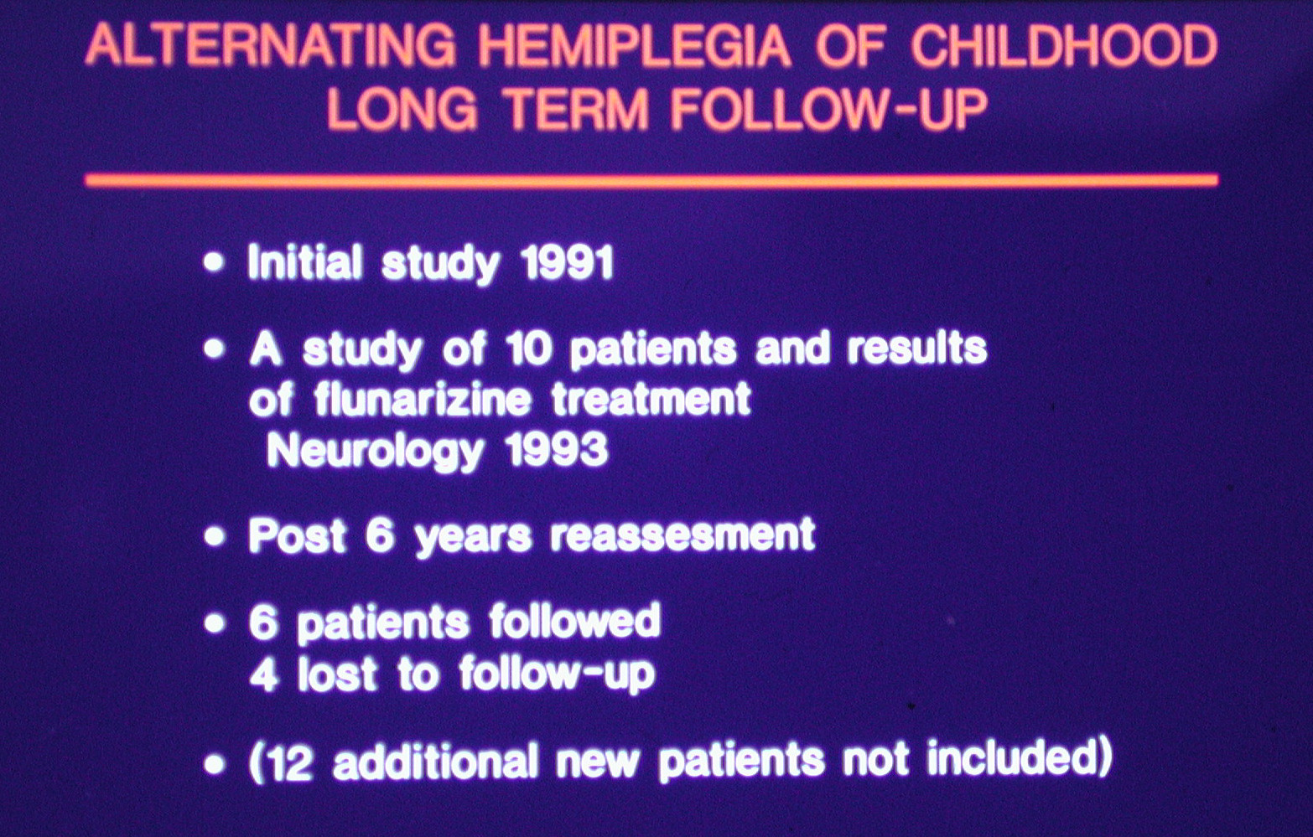

Slide 32
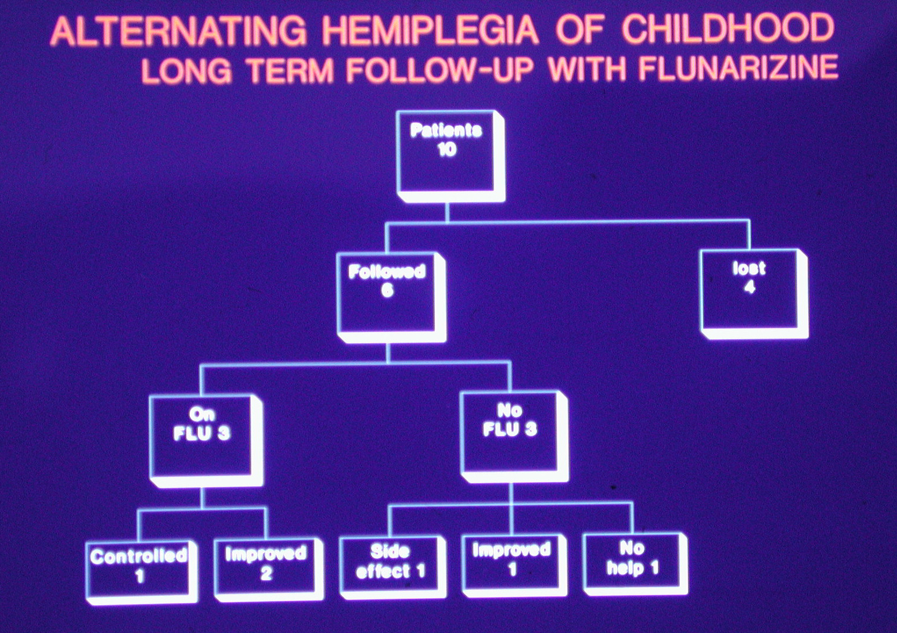

Slide 33
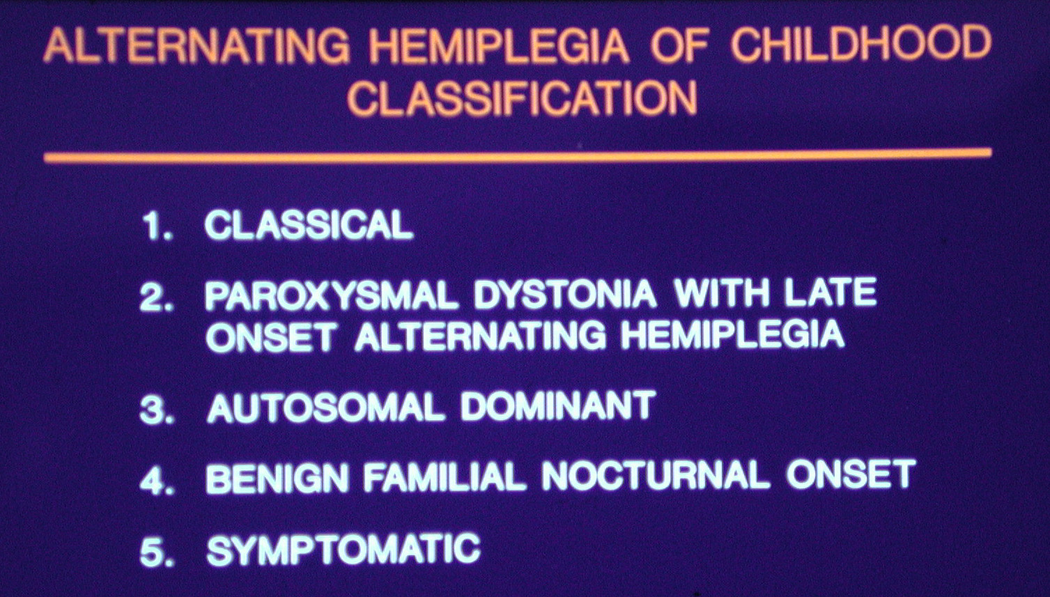

Slide 34
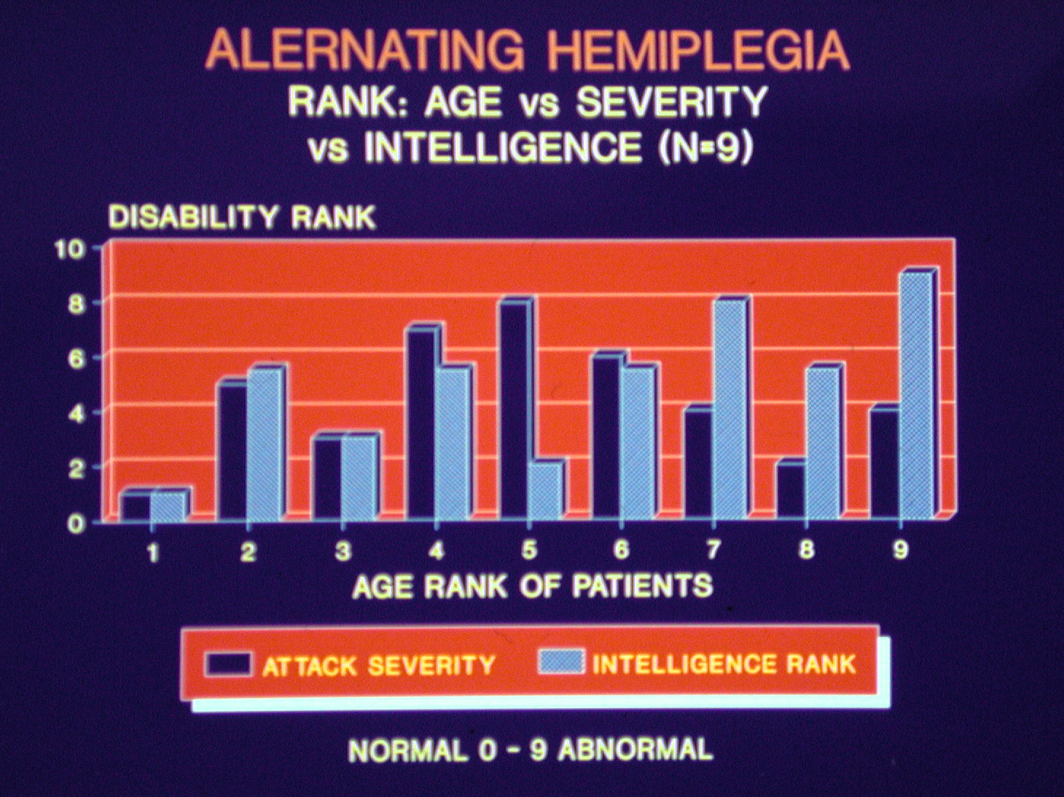

Slide 35
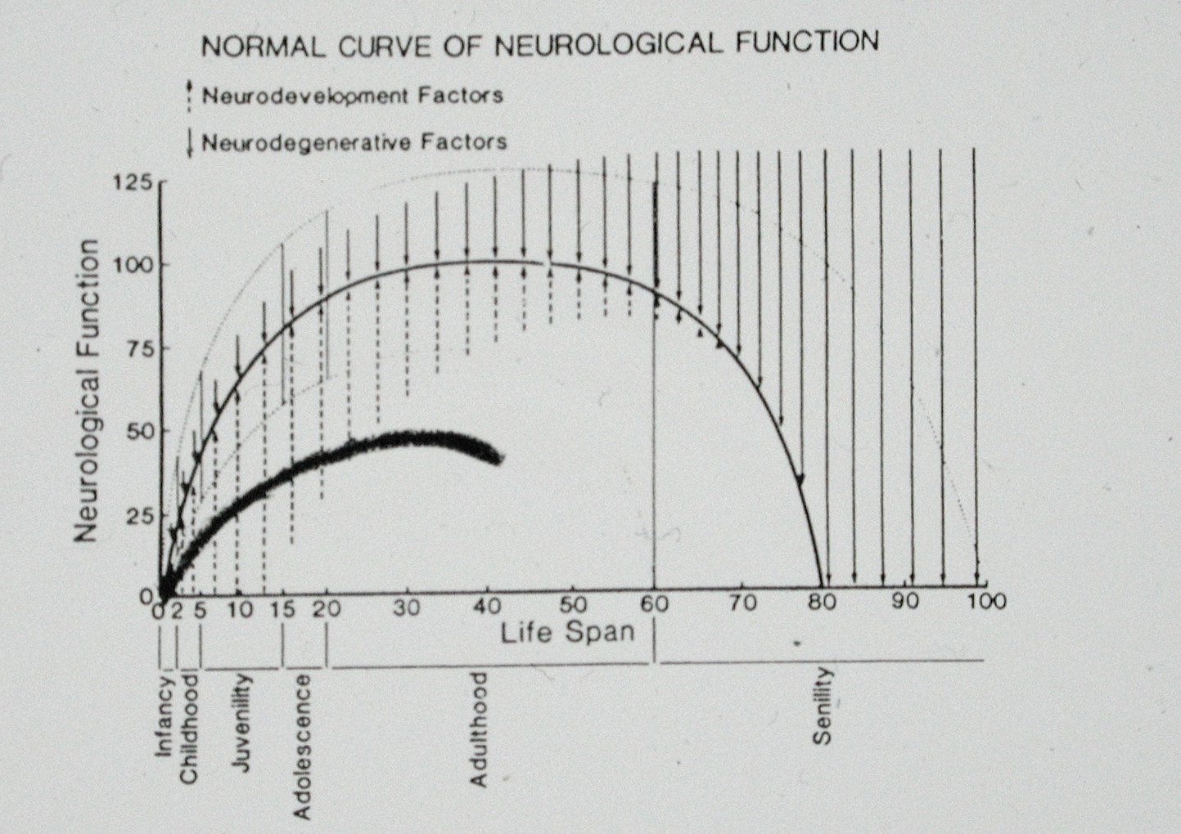

Slide 36
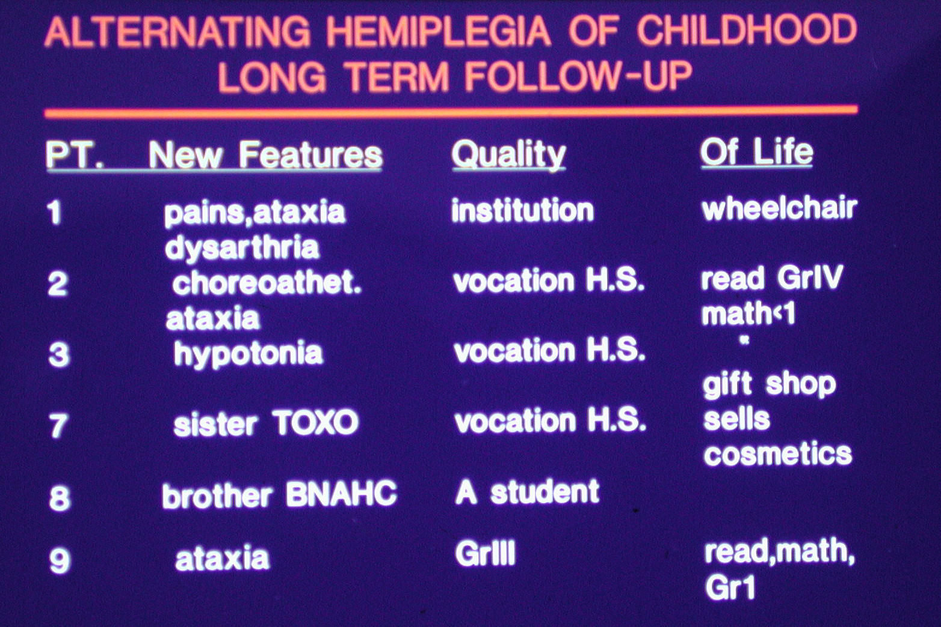

Slide 37
International Classification of Functioning, Disability and Health in subjects with alternating hemiplegia of childhood
ROSARIO MONTIROSSO, ELISA CEPPI, CHIARA D’ALOISIO, CLAUDIO ZUCCA
Disability and Rehabilitation, 2009; 31(S1): S108–S115
Table III. Percentages of ICF-CY items in the activity and participation component.
Items Age range Total
3–6 yr (N=7) 7–12 yr (N=5) 13–18 yr (N=6) >18 years (N=7) (N=25)
Speaking 57 60 50 29 48
non-verbal-
messages 29 40 33 14 28
Walking 29 60 67 71 56
interpersonal-
interactions 57 60 50 43 52

Slide 38
Evidence of a non-progressive course of alternating hemiplegia of childhood: study of a large cohort of children and adults Brain 2010: 133; 3598–3610
Panagiotakaki,1 Giuseppe Gobbi,2 Brian Neville,3 Friedrich Ebinger,4 Jaume Campistol,5
Sonˇ a Nevsˇı´malova´ ,6 Laura Laan,7 Paul Casaer,8 Georg Spiel,9 Melania Giannotta,2 C Fons,5
Miriam Ninan,3 Guenter Sange,9 Tsveta Schyns,10 Rosaria Vavassori,10 Dominique Poncelin,10
The ENRAH Consortium10,* and Alexis Arzimanoglou1,11
Paroxysmal features of AHC at different ages in a subset of 14 patients each with at least 24 years follow-up period.

Slide 39
Evidence of a non-progressive course of alternating hemiplegia of childhood: study of a large cohort of children and adults Brain 2010: 133; 3598–3610
Panagiotakaki,1 Giuseppe Gobbi,2 Brian Neville,3 Friedrich Ebinger,4 Jaume Campistol,5
Sonˇ a Nevsˇı´malova´ ,6 Laura Laan,7 Paul Casaer,8 Georg Spiel,9 Melania Giannotta,2 C Fons,5
Miriam Ninan,3 Guenter Sange,9 Tsveta Schyns,10 Rosaria Vavassori,10 Dominique Poncelin,10
The ENRAH Consortium10,* and Alexis Arzimanoglou1,11
Paroxysmal features of AHC at different ages in a subset of 14 patients each with at least 24 years follow-up period.

Slide 40
ALTERNATING HEMIPLEGIA OF CHILDHOOD: Prevalence
AHCF
173 US patients
Population USA 300 million
Prevalence 1.7: million
Pediatric Neurologists 1500
Likelihood to treat 30%
Mortality: 7 deaths in 13 years
Cause of Death Unknown
Mortality Rate of 0.3% per year
Study subjects N=103; 3 deaths in 10 years.

