Slide 1

MEDICAL HOME PROJECT for Children with Special Health Care Needs mcoleman@chori.org

Slide 2
MEDICAL HOME PROJECT for Children with Special Health Care Needs
Acknowledgments:
Parents Helping Parents, Santa Clara County California Children’s Services, San Andreas Regional Center, and Santa Clara County Office of Education, Center For Medical Home Improvement, and Children’s Hospital and Research Institute Oakland

Slide 3
What is a Medical Home?
It is NOT a Place …..
It is an approach to providing care that emphasizes “home” as a:
  Headquarters for care
  Accessible, Family Centered, Continuous, Comprehensive, Coordinated, Compassionate, Culturally Competent
  Place to be recognized, welcomed, supported, and connected to the community
Notes:
Accessible-care is provided in child’s community
-All insurance, including medi-caid, is accepted and changes are accommodated
Family Centered-recognition family is the principal caregiver and center of strength and support for children
-Unbiased and complete information is shared on an ongoing basis
Continuous-same primary pediatric health care professionals from infancy-adolescence
-Assistance with transitions (school, home, adult services) is provided
Comprehensive-health care is available 24hr/7 days a week
Preventative, primary and tertiary care needs provided
Coordinated-families are linked to support, educational and community-based services
Information is centralized
Compassionate-concern for well being of child and family is expressed and demonstrated
Culturally Effective-Families cultural background is recognized, valued and respected

Slide 4
A Medical Home for whom?
Children with Special Health Care Needs
  who have (or are at risk for) chronic physical, developmental, behavioral, or emotional conditions
  who require health and related services of a type or amount beyond that required by children generally (USMCHB, ’97)
16-18 % of all children…12 million children

Slide 5
Real Time Assessment of CSHCN Prevalence
CSHCN Screener 2-
Parent must report that the child has “a condition that has lasted or is expected to last at least one year,” and also must report that the condition resulted in at least one of the following consequences for the child:
Use of prescription medications
Use of medical care, mental health or educational services than is more than usual
Child is limited or prevented in any way in his ability to do the thinks most children of the same age can
Use of special therapies
Emotional, developmental or behavioral services

Slide 6
A Medical Home for whom?
Children with Special Health Care Needs
  An environmentally contextualized health-related limitation in a child’s existing or emergent capacity to perform developmentally appropriate activities and participate as desired in society.
  Defining disability as a limitation rather than a health condition per se highlights the social and technological context of the individual. (Currie and Kahn 2012)

Slide 7
A Medical Home for whom?
If we focus on limitation then outcome measures can focus on improvement in child and family function rather than on items that emphasize counting access to a usual source of care or numbers of ER visits, for example.

Slide 8

A Medical Home for whom?
Medical Home is one way to improve child and family functioning by:
Providing appropriate integrated care and Promoting advocacy.

Slide 9
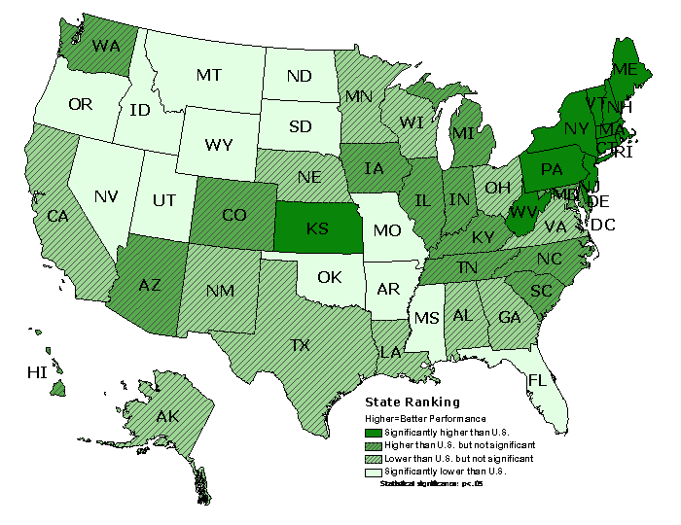
CSHCN who are screened early and continuously for special health care needs
National-78.6% Range 64.9% to 89.1%

Slide 10
Why now?
The number of children with chronic conditions is increasing
Home and community-based care is preferred
Care has become increasingly fragmented
Healthy People 2010 goal:
  “All children with special health care needs will receive comprehensive care in a medical home” by 2010

Slide 11
Healthy People 2020 Goal: Promote the Health and Well-Being of People with Disabilities
Demonstrate specific health disparities for people with disabilities. Compared with people without disabilities, people with disabilities are more likely to:
Experience difficulties or delays in getting the health care they need.
Not have had an annual dental visit.
Not have had a mammogram in past 2 years.
Not have had a Pap test within the past 3 years.
Not engage in fitness activities.
Use tobacco.
Be overweight or obese.
Have high blood pressure.
Experience symptoms of psychological distress.
Receive less social-emotional support.
Have lower employment rates.

Slide 12
Fully Developed Medical Homes
New set of primary care behaviors
Chronic Condition Management…..
Serve children and families who use the health care system most often
Expand services to include
  Care coordination
  Advocacy
  Information exchange & family education

Slide 13
Pediatric Primary Care Characteristics
Designed for 80% of children who do not have special health care needs
Designed to provide well child preventive care services and acute illness management
Designed to support a single service unit: the provider-patient encounter

Slide 14
Benefits of Medical Home
Decreased time in the ICU, fewer ER visits and hospitalizations and fewer hospital days when admitted
Increased timeliness in filling Rx’s, making appts, phone calls returned
Increased effectiveness of medical treatment
Improved family function, more likely to receive written care plan
Fewer illnesses and symptoms
Less school absences
Cost savings for hospitals and clinics mixed

Slide 16

National Initiatives to Promote Medical Home Improvement
National Center for Medical Home Initiatives sponsored by:
  American Academy of Pediatrics
  Family Voices
  Shriners
  National Association of Children’s Hospitals and Related Institutions
  Maternal and Child Health Bureau
Notes:
Started in 1999 with funding from MCHB
Previously the initiative was known as the medical home program for children with special needs started in 1994

Slide 17
California Medical Home Project
Statewide Coalition
  members of the AAP, pediatricians, agencies that support CSHCN’s, family support groups, subspecialists
California Health Care Foundation
  Coordination and Support Center
  7 local community based coalitions
Notes:
California Health Care Foundation
Statewide Coalition –members of the AAP, pediatricians, agencies that support CSHCN’s, family support groups, subspecialists
Coordination and Support Center
7 local community based coalitions-Alameda,
Contra Costa, Shasta, Yolo-Solano-Napa, Santa Clara, Los Angeles, San Benito

Slide 18
Santa Clara Medical Home Project Goals
Assist families, providers and agencies in providing care for CSHCN’s
  Establish a local Medical Home coalition
  Perform needs assessment-Families, Agencies and Physicians
  Develop and evaluate tools to improve coordination of services
  Provide local Medical Home training programs
Notes:
Families-survey needs and areas of satisfaction and concern in caring for their children
-develop tools for families to organize child’s records and services
-train families in the principles of the medical home, family centered care, care coordination and parent/professional collaboration
Providers-survey for needs and concerns in taking care of CSHCN’s
-develop tools to improve access to services for CSHCN’s
-provide training and support on establishing medical homes
-increase network of medical homes
Agencies-survey agencies and their clients to determine level of family centered care,
-develop seamless set of services, single point of entry
-identify areas of duplication, barriers to access
Parents Helping Parents
Community Pediatricians
California Children’s Services (CCS)
San Andreas Regional Center (SARC)
United Cerebral Palsy (UCP)
Santa Clara County Office of Education
Santa Clara Family Health Plan
Lucille Packard Children’s Hospital
Kaiser Permanente
Valley Medical Center
Child Health & Disability Prevention (CHDP)
Oral Health Collaborative
County Office of Mental Health

Slide 19
Family Survey
Notes:
2000/6000 CCS families were randomly selected.
1400 non-Spanish speaking and 600 Spanish-speaking
Mailings twice
Data on first 200 that have been entered

Slide 20
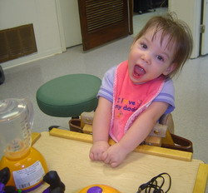

Slide 21
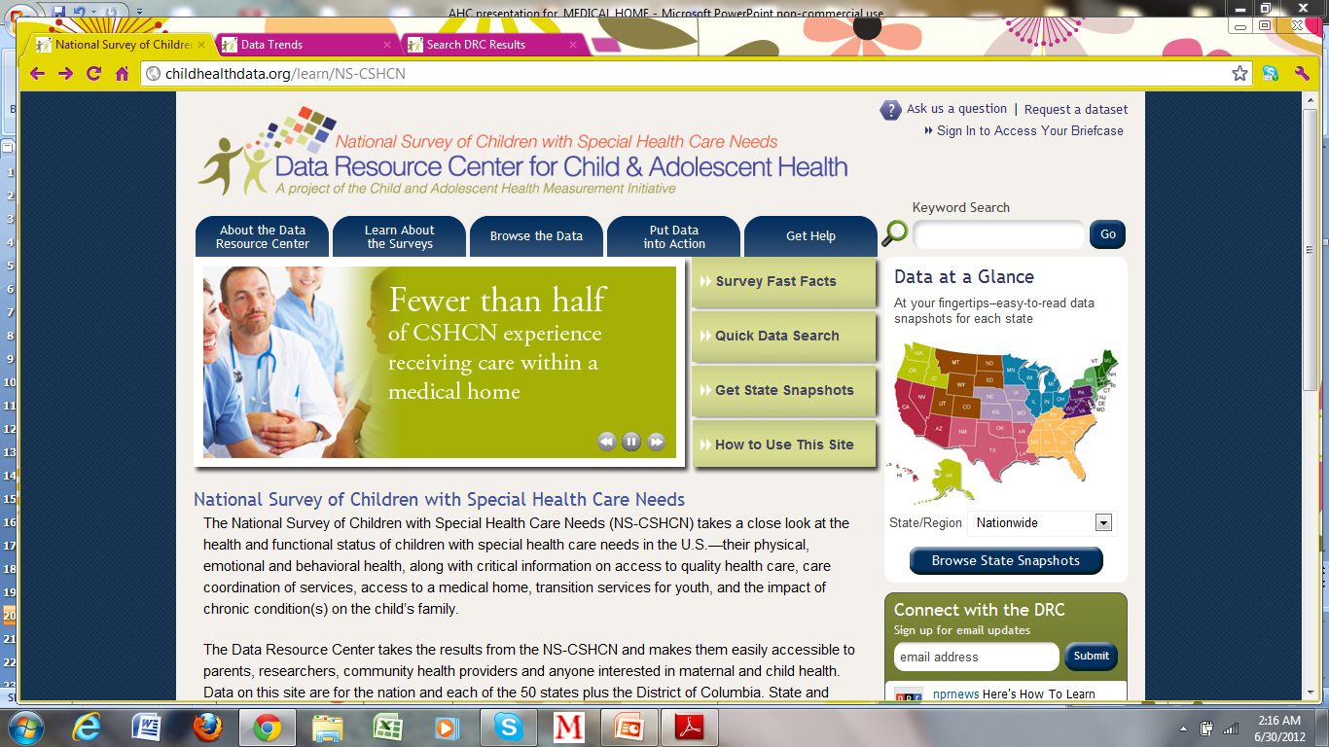

Slide 22
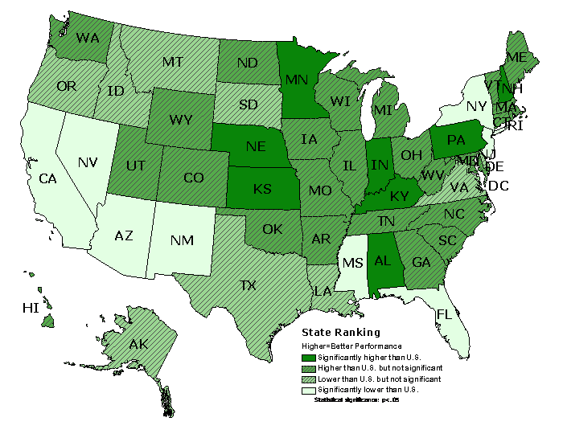
CSHCN with a Medical Home
43.0% of CSHCN met outcome
Range 34.2% to 50.7%

Slide 23
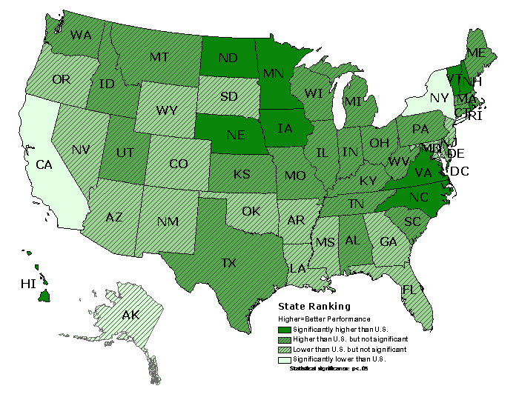
CSHCN whose families are partners in decision making at all levels, and who are satisfied with services they receive
70.3% of CSHCN met outcome Range 61.8% to 77.6%

Slide 24
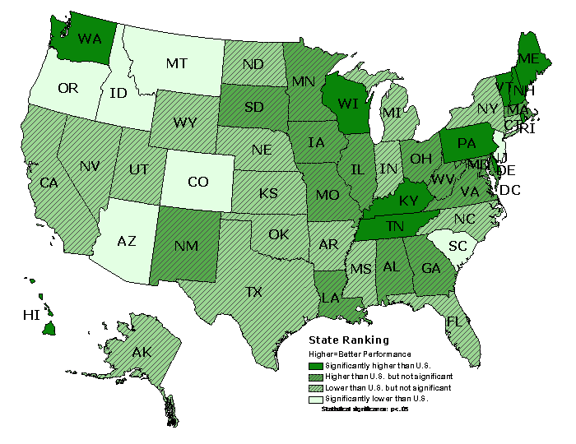
CSHCN whose families have adequate public and/or private insurance to pay for the services they need
60.6% of CSHCN met outcome Range 49.9% to 72.6%

Slide 25
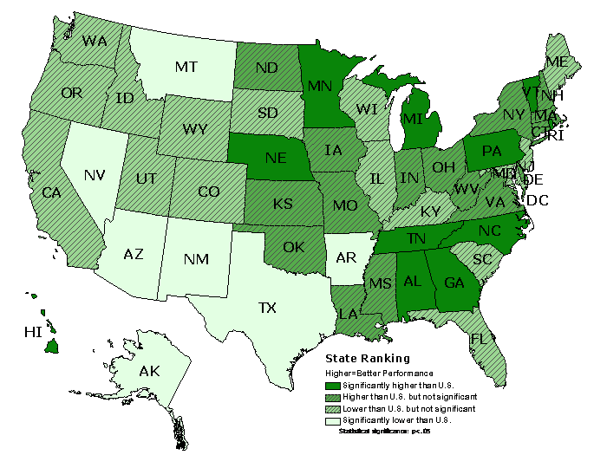
Community-based services are organized for ease of use
65.1% of CSHCN met outcome Range 54.3% to 73.5%

Slide 26
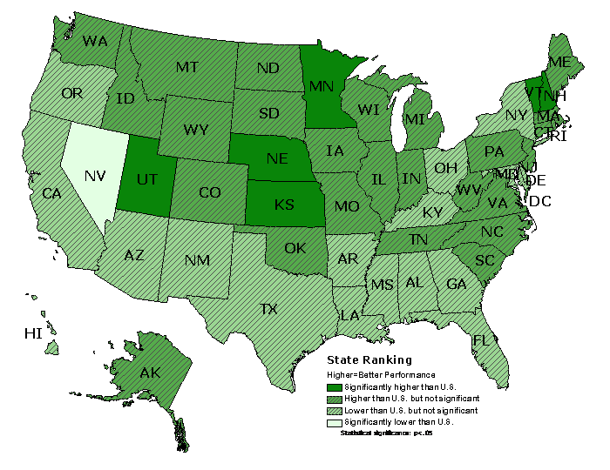
CSHCN Youth receive services needed for transition to adulthood (ages 12-17 only)
40.0% met outcome Range 31.7% to 52.7%

Slide 27
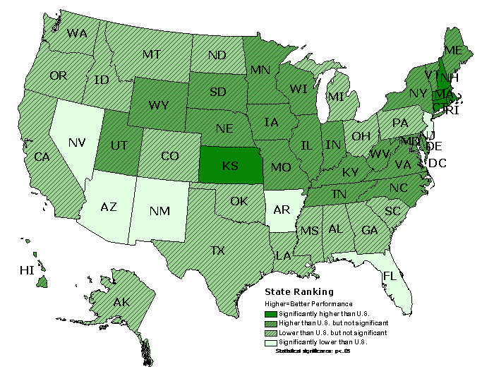
Met All 6 Core Outcomes (ages 12-17 only)
13.6% of CSHCN met outcome Range 7.5% to 22.2%

Slide 28
CSHCN National Survey 2009/10
Topic | Nationwide % | Range %
CSHCN whose conditions affect their activities | 27.1 | 19.1-32.5
CSHCN with 11 or more days of school absences due to illness | 15.5 | 10.8-23.5
CSHCN with any unmet need for family support services | 7.2 | 4.0 to 10.3

Slide 29
CSHCN National Survey 2009/10
Topic | Nationwide % | Range %
CSHCN without insurance at time of survey | 27.1 | 19.1-32.5
Currently insured CSHCN whose insurance is inadequate | 34.3 | 25.5-44.8
CSHCN without insurance at some point during past year | 9.3 | 3.2-16.4

Slide 30
CSHCN National Survey 2009/10
Topic | Nationwide % | Range %
CSHCN with any unmet need for specific health care services | 8.8 | 4.3-14.9
CSHCN needing a referral who have difficulty getting it | 23.4 | 12.6 to 35.8
CSHCN without a usual source of care when sick | 9.5 | 6.0 to 14.7

Slide 31
CSHCN National Survey 2009/10
Topic | Nationwide % | Range %
CSHCN without any personal doctor or nurse | 6.9 | 3.4 to 13.4
CSHCN without family-centered care | 35.4 | 27.7 to 44.2
CSHCN without a usual source of care when sick | 9.5 | 6.0 to 14.7
CSHCN whose families pay $1,000 or more out-of-pocket | 22.1 | 14.6 to 34.3

Slide 32
CSHCN National Survey 2009/10
Topic | Nationwide % | Range %
CSHCN whose conditions cause financial problems for family | 21.6 | 14.0 to 29.8
CSHCN whose families spend 11 or more hours per week providing health care | 13.1 | 8.9 to 19.5
CSHCN whose conditions cause family members to cut back or stop working | 25.0 | 17.6 to 29.4

Slide 33
Multiple Health Conditions
Asthma/Lung Disease
Cerebral Palsy
Vision Impairment
Heart Disease
Deafness/Hearing Impairment
Seizure
Mental Retardation/Global Delay

Slide 34
Multiple Health Conditions
GI/Liver Disease
ADHD
Chronic Ear Infection
Depression/Anxiety/Emotional Illness
Leg/Arm Deformity
Other Cerebral/Neurological Disorder
Hemophilia/Thalassemia/Blood Dyscrasia

Slide 35
Difficulty in Caring for Your Child
Notes:
CHMI >50% somewhat to very difficult in caring for child Health is better but harder to care for
SC 35% somewhat to very difficult in caring for child

Slide 36
Non-CCS Covered Conditions

Slide 37
Non-Covered CCS Client’s Health Conditions
Depression/Anxiety/Emotional Illness
Down Syndrome
Eating Disorder Autism/PDD
LD/Develop. Delay Severe Allergies
Mental Retardation/Global Delay

Slide 38
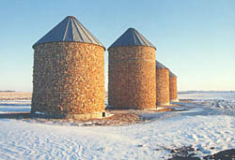
Silos of Services

Slide 39
Family Survey
Notes:
CCS-48%
SARC-23%
COE-14%
PHP-14%
Mental Health-1%
Other-1%-UCP-.7%, CLA, Local School District, Primary care

Slide 40
Notes:
Medi-cal-61%
CCS-48%
SCFHP-42%
SSI-22%
HF-20%
Private Insurance-20%
CHDP-5%
Healthy Kids-8%
Kaiser-4%
Blue Cross-.4%

Slide 41
Family Survey
Out of Pocket Expenses >$25/month……………38%/51%
Medicines
Supplies
Doctors/Hospitals
Equipment
Transportation
Adaptive clothing and toys
Diapers
Respite
Family Support
Insurance Premiums
Food/Formula
Private Education
PT/OT
Tutoring
Counseling
Surgeries
Dental

Slide 42
PCP Visits/Yr

Slide 43
Specialist Visits/Yr

Slide 44
ER Visits/Yr

Slide 45
# of Hospital Stays/Yr

Slide 46
Hospital Nights/Yr

Slide 47
Family Survey
Days of Work Lost Due to Child’s Condition
None | 63%/41
1-5 Days | 25%/35
1-3 Weeks | 8%/9
Month or More | 4%/3.5

Slide 48
Family Survey
Employed Full Time
Mother……19%/35%
Father……..50%/55%
Only 7% of parents both work
full-time

Slide 49
School

Slide 50
School Absences
In Last 3 months
None | 1-5 Days | 1-3 Weeks | > 1 Month
50% | 35% | 13% | 2%
42% | 29% | 11% | 6%

Slide 51
School Success
Principal……….12%
Teacher………..39%
School Nurse….11%
Resource Spec.11%
Class Aide…….18%
Tutor…………….3%
Sp. Ed Teacher.22%
Other…………....3%

Slide 52
Who Do You Call with Concerns About Your Child?
Principal….12%
Teacher…..29%
School Nurse…….. .9%
Resource Spec………..6%
Class Aide…………4%
Sp. Ed Teacher……15%
No one to call……1%

Slide 53
Family Survey
Child Concerns
In the last 3 months how often have you worried about your child’s health?
  64% worried some, most or all of the time
Talked to someone about worries?
  39% yes
  61% no
Who do you talk to?
  Doctors, family and friends, school staff

Slide 54
Child Concerns
Who Do You Talk To?

Slide 55
Family Survey
Child Concerns
Growth/Development…………….57%/77%
Ability to Learn……………………54%/71%
Falling Behind in School………...49%/67%
Making and Keeping Friends…...41%/65%
Participation in activities with his/her
age group…………………………48%/77%
Notes:
Always, often, sometimes

Slide 56
Family Survey
Child Concerns
Learning self help medical skills…….42%/77%
Being Independent…………………....43%/67%
Making choices…………………….….42%
Self-esteem…………………………....46%
Future…………………………………..62%
Unhealthy Behaviors………………….18%
Always, often, sometimes

Slide 57
Family Survey
Primary Responsibility for Care Coordination:
  Mother 84%
  Father 13%
  PCP 6%
  Other relative 6%
  Specialist 6%
  Office Care Coordinator/Nurse 1%
  Friend 0%
  Other Person 1%

Slide 58

Family Satisfaction
Physician Skills
Family Care Coordination Skills
Office Practice
Office Quality

Slide 59
Family Survey
Medical Care Satisfaction
Mean Rating=3.8/4.
(Very Good-Good on 12 measures)
  ex. The PCP’s sensitivity to cultural background..4.2
  Effort to put parent in touch with other parents with similar concerns***………2.8
Notes:
Satisfaction with Medical care PCP provides
Ex. The PCP’s skill in managing your child’s condition is……………..

Slide 60
Parent/Caregiver PCP Satisfaction
Notes:
PCP satisfaction
5=excellent
4=very good
3=good
2=fair
1=poor

Slide 61
Local PCP Office Practice Satisfaction
Notes:
Contact specialist-Family Feedback
5=always
4=often
3=Sometimes
2=rarely
1=never
Contact child’s specialist as needed………………………….(3.7/4)
Adequate time for questions.(4.2/4.5)
Manages visits to specialist..(3.6/3.8)
Help to express concerns……..(3.9/4)
Advice on developmental…..(3.8/3.9)
Active feedback for service improvement…………………....(3.0/X)
Mean= 3.8/4 (Often-Sometimes)

Slide 62
Local PCP Office Practice Quality
Notes:
Office wait time..............................(3.0/3.7)
Staff help by phone………….…….(3.3/4)
Clear directions to
other medical sites…......................(3.5/4)
Phone access……….....................(3.1/3.7)
Referral help for non-ill needs…….(3.4/3.9)
Regular contact w/school……........(2.7/2.6)
Mean= 3.2/3.7 (Good)
Office wait-school contact
5-excellent
4=Very Good
3=Good
2=Fair
1=Poor

Slide 63
Family Care Coordination Skills
Notes:
Family Rating
5=always perform this task
4=often
3=Sometimes
2=rarely
1=never perform this task
Mean Rating = 3.9/4(Often-Sometimes/Often) on family ratings of care coordination abilities on 17 measures
ex. Comfortably providing my child the needed medical treatments at home……..
10 areas of difficulty:
Taking positive action to correct poor care services (3.9)
Finding the help I need to coordinate services (3.6)
Describe how this medical condition effects my child’s growth and development (3.5)
Getting child to take active role in health decision making (3.3)
10 areas of difficulty:
Involving my child in regular recreational activities (3.2)
Finding other parents of children with similar conditions to talk to (2.6)
Competent home nursing care (2.3)
Respite (3.1)*

Slide 64
Family Survey
Top Family Needs:
  Medical Insurance for Child/Family
  Planning for Child’s Future
  Eligible Services/Financial Assistance
  Special Equipment, Supplies, Therapy
  Community Programs or Organization
  Managing Family Stress
  Housing
  Helping Child Make Friends

Slide 65
Family Survey
Top Family Needs:
  Behavior Management
  Meeting other Parents with Similar Children
  Transportation
  Community Recreation
  Local Dental Care
  Good Care for Child’s Chronic Conditions
  Regular Daycare/Childcare
  Finding Someone to Help Me Obtain Services for My Family
  Vacationing with My Child

Slide 66
Provider Survey

Slide 67
Provider Survey
Notes:
How familiar/knowledgeable is PCP w/ concept of MH?
How familiar/knowledgeable is PCP w/ elements of family centered care?
How familiar/knowledgeable is staff w/ concept of MH?
How familiar/knowledgeable is PCP w/ elements of family centered care.
Scale
Know knowledge of concept
Some knowledge/not applied
Knowledgeable/concept sometimes applied
Knowledgeable/concept regularly applied

Slide 68
Provider Survey
Care Coordinator in Office
PCP’s NH/VT 31%
SC Pediatricians 14%
SC Subspecialists 50%

Slide 69
Provider Survey

Slide 70
Provider Survey
Notes:
Do you have a data management system for:
Identifying CSHCN
Tracking Progress
Monitoring Outcomes

Slide 71
Provider Survey
Notes:
In the past 2 years have you?
Solicited family feedback from parents/caregivers of CSHCN
Referred families to parent support
Initiated outreach in your community concerning CSHCN and their families
Participated in QI activities for CSHCN
Included families with CSHCN in improvement activities

Slide 72
Notes:
What are some of the obstacles you face in caring for CSHCN?
Time
Reimbursement
Comm w/ schools
Comm w/comm agencies
Rare conditions
Changing Comm Resources
Follow-up Ability

Slide 73

Where do we go from here?

Slide 74

Is This A Medical Home??
Where do we go from here?

Slide 75
Healthy People 2020 Goals for Persons With Disabilities
Include in the core of Healthy People 2020 population data systems a standardized set of questions that identify “people with disabilities”
Reduce the proportion of people with disabilities who report delays in receiving primary and periodic preventive care due to specific barriers
Increase the proportion of youth with special health care needs whose health care provider has discussed transition planning form pediatric to adult health care
Reduce the proportion of people with disability who encounter barriers to participating in home, school, work or community activities

Slide 76
Healthy People 2020 Goals for Persons With Disabilities
Reduce barriers to obtaining the assistive devices, service animals, technology services, and accessible technologies that they need
Increase the proportion of people with disabilities who participate in social, spiritual, recreational, community, and civic activities to the degree that they wish
Reduce the proportion of people with disability who report serious psychological distress
Reduce the proportion of people with disabilities who experience nonfatal unintentional injuries that require medical care
Increase the proportion of children with disabilities, 0-2 who receive early intervention services in home or
community-based settings

Slide 77
Family Tools
Medical Home Notebook Development and Training
Emergency Room Plan
Care Plan
Office Survey Tools
Provider Visit Contact Sheet

Slide 78
Provider Tools
Single Point of Entry for Early Intervention Services
Provider Contact Sheet and
Specialty Referral Form
Local Resource Agency List

Slide 79
Next Steps
Distribute, Evaluate and Adapt Tools (translate materials)
Start Agency/Family Advisory Groups
Provide Medical Home Training to Healthcare Providers & Families and
Monitor Outcomes
Begin Universal Development and Behavior Screening in PCP Offices/Day Care and Shelters

Slide 80

Advocacy
Act as if what you do makes a difference. It does.

