Slide 1
Seizures in Alternating Hemiplegia of Childhood
Mohamad Mikati MD
Wilburt C. Davison Professor of Pediatrics,
Professor of Neurobiology, Chief of Pediatric Neurology,
Duke University Medical Center

Slide 2
Milestones in AHC and Parallels with Epilepsy
Defining the Syndrome:
Registries:
Verret and Steele, 1971
Casaer and Azou, 1984
Aicardi, 1987
Mikati et al, 2000
Sweney et al 2009,
Panagiotakaki et al 2010
Foundations
France (families/J. Aicardi, 1992)
USA (families/M. Mikati 1993)
Other countries
Genetics:
Mikati et al, 1992
Swoboda et al, 2004
Bassi et al, 2004

Slide 3
Outline
Distinction Between Seizures and AHC spells
Studies of Seizures in AHC
Therapy

Slide 4
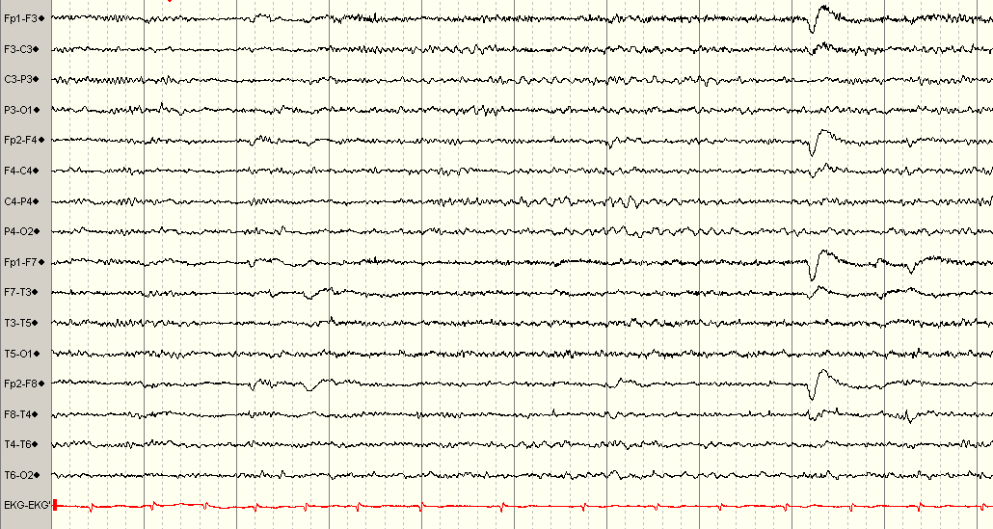
Epileptic Seizures
Occurrence of signs and/or symptoms due to abnormal excessive or synchronous neuronal activity
Normal EEG:

Slide 5
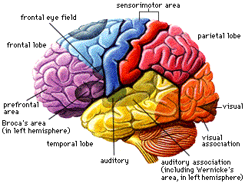
EEG During Epileptic Seizures
Focal Ictal Discharge
Generalized Discharges

Slide 6
EEG Changes Interictally
Focal Discharges
Generalized Discharges

Slide 7
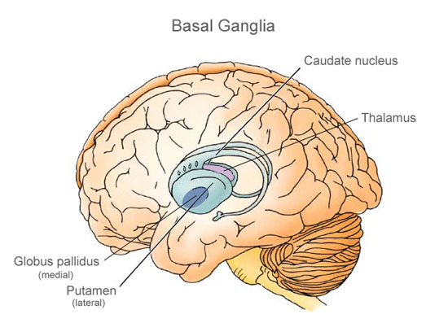
Abnormal Movements
Basal ganglia
Dystonic/tonic
Choreoathetosis
tremor
Brain stem
Nystagmus
Cerebellar
Ataxia
tremor

Slide 8
Video Illustrations
Epileptic Hemiplegia focal epileptic seizure starting with dystonia like movement, the generalized stiffening then focal weakness.
Epileptic Dystonic seizure
Epileptic Tonic seizure
Dystonia in a case of AHC
Hemiplegia in a case of AHC
Myoclonic seizure in a case of AHC

Slide 9
Epileptic Hemiplegia
Video here

Slide 10
Epileptic Dystonia
Video here

Slide 11
Epileptic Tonic Seizure
Video here

Slide 12
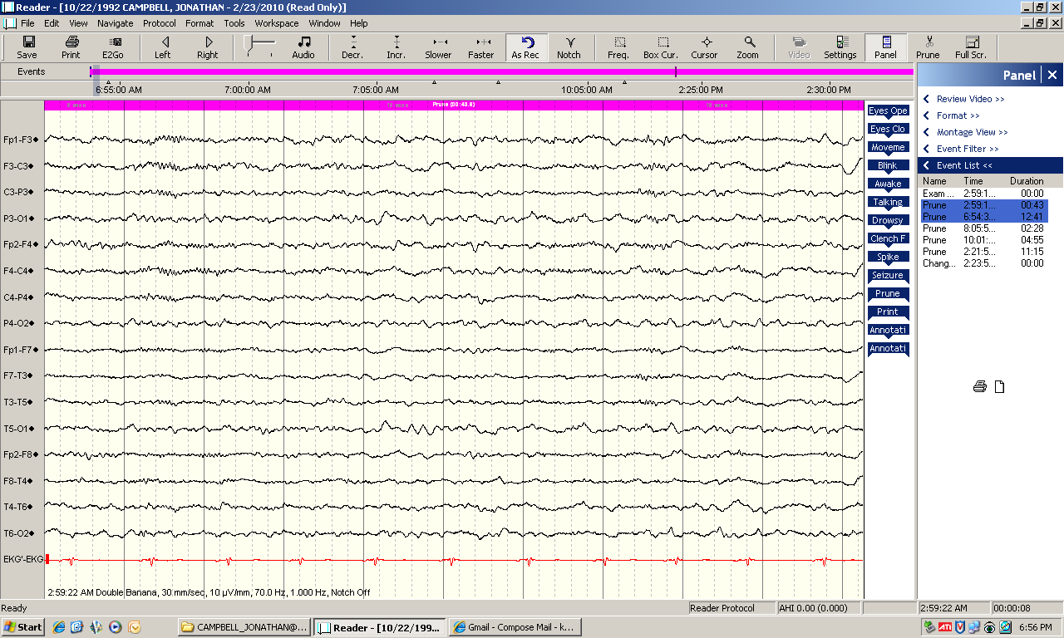
AHC Case: Baseline EEG

Slide 13
Dystonia in AHC
Video here.

Slide 14
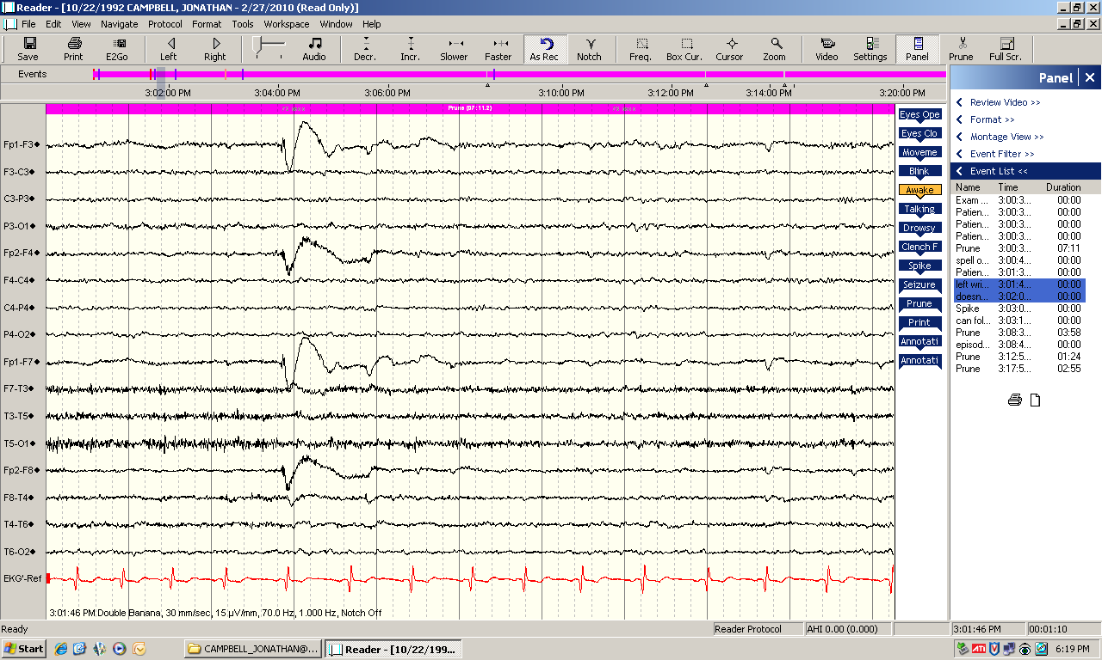
AHC Case: EEG in Dystonia

Slide 15
Hemiplegic Spell in AHC
Video here.

Slide 16
AHC Case: EEG in Hemiplegia

Slide 17
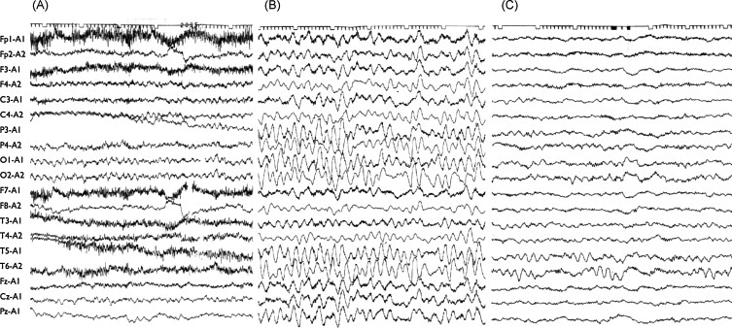
EEG During Hemiplegia in Patient with AHC
(A) Patient 1 during right hemiplegia at age 3 years (B and C) Patient 3 at age 11 months, during right hemiplegia (B) and after resolution of hemiplegia (C)

Slide 18
Myoclonic Seizures
Video here.

Slide 19
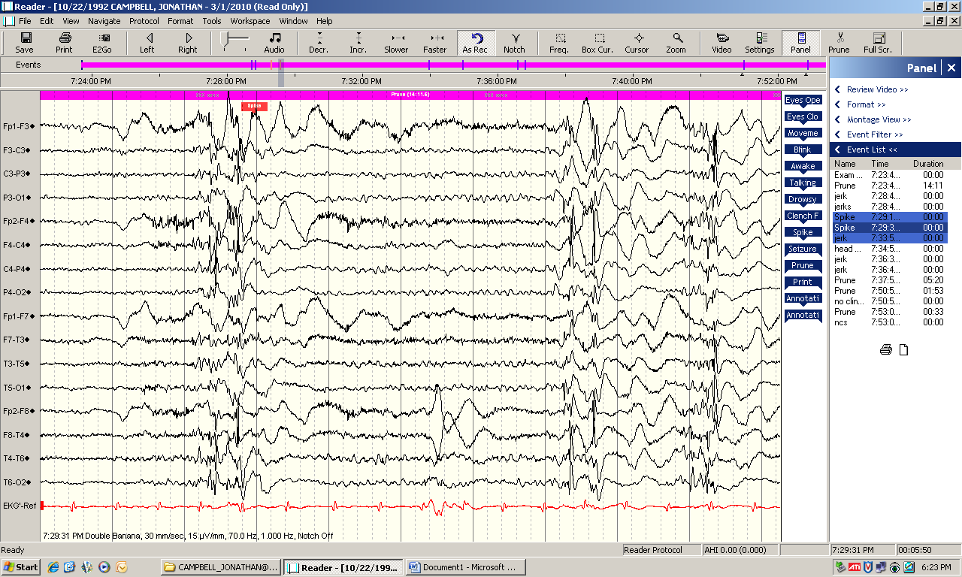
AHC Case: EEG of Myoclonic Jerks

Slide 20
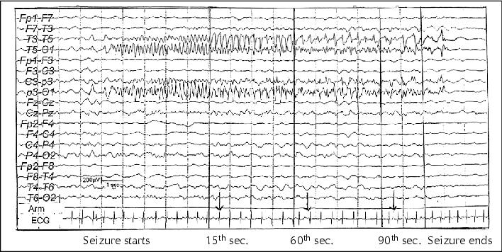
EEG During Epileptic Seizure in AHC
Ictal EEG. Seizures were captured as frequent, jerky awakenings from sleep, followed by unilateral attacks with a slow, forced deviation of the head and eyes to the right or the left side accompanied by an ipsilateral tonic extension of the arm and the leg which lasted for a few minutes. They sometimes lasted longer; -i.e. up to 15 minutes when the tonic posturing could become global

Slide 21
Outline
Distinction Between Seizures and AHC spells
Studies of Seizures in AHC
Therapy

Slide 22
Mikati Study
We studied 44 patients
8/44 (19%) fit the strict criteria requiring consistent EEG, ictal or interictal,
Not considered epileptic:
Many other patients with tonic episodes who though responding to IV Diazepam failed subsequent antiepileptic drug treatment without video EEG monitoring
Mikati et al., Pediatric Neurology 2000: 23(1);134-141

Slide 23
Frequency of Seizure Activity
8/44 patients (19%) experienced seizures sometime in their life
4 had infrequent seizures (50%) with a total of 3 or fewer seizures each
4 had frequent seizures (50%) with one having history of status epilepticus
4 had generalized tonic clonic 3 focal and one myoclonic seizures
Mikati et al., Pediatric Neurology 2000: 23(1);134-141

Slide 24
Sweney Study
44/103 (43%) were reported to have epilepsy
Occurrence of generalized tonic or tonic-clonic seizures with altered consciousness considered seizures, other seizure types
Mean age of onset 6 years
Most, 34, (77%) were reported to have onset < age 10 years
Focal and generalized seizures and EEG findings reported

Slide 25
Panagiotakaki Study: Frequency of Seizures with Age Cohort with > 24 year FU
*
*
*
53% had seizures, 52-75% depending on age were controlled

Slide 26
Other Seizure Manifestations
Neonatal onset 12.5% of patients, 3 % first day
Presumed Gelastic seizures in 3%
Aura of irritability, dysethesias of limbs and throat or body
Sudden unexpected death (7/157) 3 with seizures, 2 with plegia, one cardiovascular failure and one unknown, these patients did not have more severe spells but were more disabled
Seizures may sometimes occur with plegic/dystonic attacks and focal epilepsia parialis continua can occur
Panagiotakaki E et al., Brain 2010: 133; 3598-3610
Neville and Ninan Dev Med child Neurol 2007;49:777-80:

Slide 27
Saito Study: Frequency
Retrospective review of clinical information on 9 patients (age: 4-40 years), seven/nine thought to have epilepsy.
Presumptive epileptic seizures in seven patients
Age of onset ranging from 2 – 16 years

Slide 28
Saito Study: Types of Seizures
Tonic
Tonic with cyanosis, nystagmus, twitching of face and extremities, clonic, cyanosis
Cyanosis
Tonic, Eyelid twitching, cyanosis
Tonic, upward gaze, tonic
Generalized tremor, myoclonus, Blinking, twitching of face and extremities, clonic movements, cyanosis
Ocular deviation, clonic/myoclonic, post-ictal respiratory arrest
Sudden fall, nystagmus, generalized clonic, cyanosis
Generalized tonic-clonic seizure
Generalized seizures
Febrile seizures
Saito et al., Epilepsy Research 2010: 90; 248-258

Slide 29
Neonatal Onset Seizures
Four patients with neonatal disease onset showed:
Lower psychomotor developmental achievements
Repeated status epilepticus followed by progressive deterioration
MRI – brain atrophy cerebellar and hippocampal high signal changes
Saito et al., Epilepsy Research 2010: 90; 248-258

Slide 30
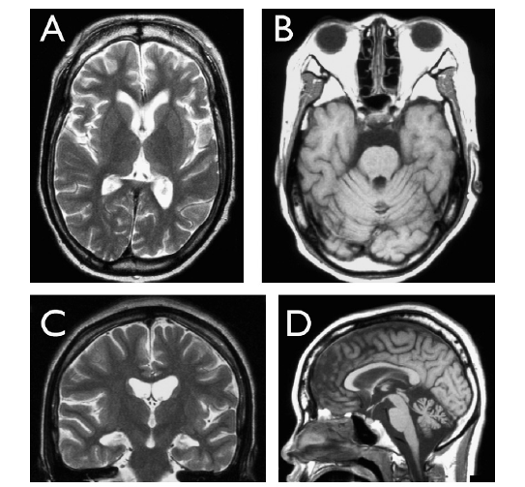
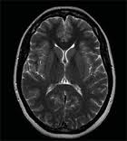
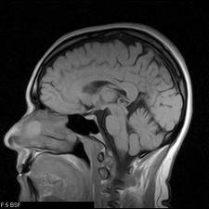
MRI in Patients with Status
Saito et al., Epilepsy Research 2010: 90; 248-258

Slide 31
Outline
Distinction Between Seizures and AHC spells
Studies of Seizures in AHC
Therapy

Slide 32
Acute Seizures
First Aid (positioning, breathing, etc..)
Rescue medications (usually benzodiazepines)
Awareness of and response to apnea
Awareness of and response to status epilepticus

Slide 33
Antiepileptic Drugs
Focal Seizure: Carbamazepine, Oxcarbazepine, Levetiracetam, Topiramate, other
Generalized and Myoclonic Seizures: Valproate, Clonazepam, Levetiracetam, Topiramate, other
Frequent follow up and reevaluations to distinguish epileptic seizures from other episodes and to consider alternative therapies is needed.

Slide 34
Conclusions
Dystonic/tonic and hemiplegic spells are difficult to distinguish from epileptic seizures but detailed history, interictal EEG, and Video EEG help distinguish them from the multiple seizure types
At least ½ are well controlled and some have difficult seizures including neonatal onset, apnea, status epilepticus.
Therapy of epilepsy in AHC is similar to that of epilepsy without AHC with modifications based on the occurrence of the above findings

Slide 35
Conclusions
Our increasing knowledge is improving our ability to help AHC patients and has increased our hopes for major discoveries in the future
Thank you for your attention

